Slide 1

CDC/IDSA COVID-19 Clinician Call
February 5, 2022
84th in a series of bi-weekly calls, initiated by CDC as a forum for information sharing among frontline clinicians caring for patients with COVID-19. This call is not intended for the media.
The views and opinions expressed here are those of the presenters and do not necessarily reflect the official policy or position of the CDC or IDSA. Involvement of CDC and IDSA should not be viewed as endorsement of any entity or individual involved.
This webinar is being recorded and can be found online at www.idsociety.org/cliniciancalls.
Welcome & Introductions
  Dana Wollins, DrPH, MGC
  Vice President, Clinical Affairs & Guidelines IDSA

Slide 2
Today’s Agenda
Welcome/Introductions
Update on Omicron
Operationalizing Outpatient COVID-19 Therapeutics: Lessons from the Field
Panel Q&A/Discussion

Slide 3

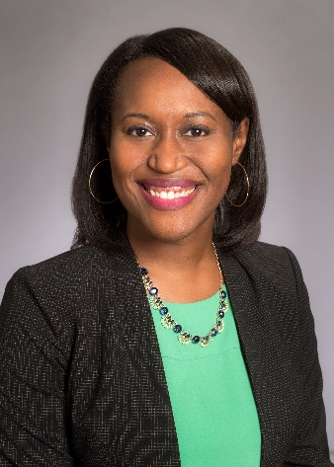


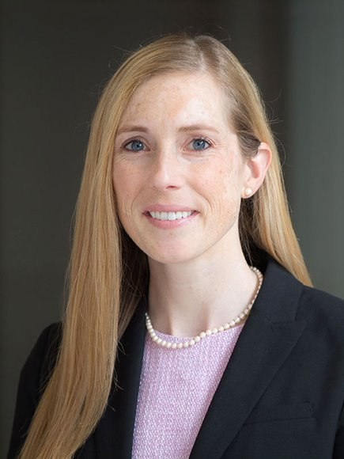






Omicron Update
Paul McClung, MD
Chief Medical Officer, CDC COVID-19 Response
U.S. Centers for Disease Control and Prevention
Operationalizing Outpatient COVID-19 Therapeutics: Lessons from the Field
Implementing Outpatient Treatment: Emory University
Zanthia Wiley, MD
Director of Antimicrobial Stewardship, Emory University Hospital Midtown
Associate Professor of Medicine, Division of Infectious Diseases
Priya Nori, MD, FSHEA, FIDSA
Medical Director, Antimicrobial Stewardship & OPAT,
ID Training Program Director,
Associate Professor of Medicine & Orthopedic Surgery, Montefiore/Einstein
Reaching Underserved Patients: Grady Health System
Sheetal Kandiah, MD
Medical Director, Antimicrobial Stewardship, Grady Health System
Associate Professor Infectious Diseases, Emory School of Medicine
Margaret “Peggy” McCort, MD
Assistant Professor, Department of Medicine (Infectious Diseases)
Montefiore/Einstein
Improving Access and Optimizing Delivery: University of Alabama-Birmingham
Sonya Heath, MD
Professor, Dept. of Medicine, Division of Infectious Diseases
Alabama Vaccine Research Clinic
Administration of Monoclonal Antibody-Real-World
Implementation
Anurag Malani, MD, FIDSA, FSHEA
Medical Director, Hospital Epidemiology, Special Pathogens and
Antimicrobial Stewardship, St. Joseph Mercy Health System
Edgar T. Overton, MD
Professor, Department of Medicine, Division of Infectious Diseases
University of Alabama
Reaching Post-Acute and Other Congregate Care Settings:
The Regional Rapid Response Assistance Program
John M. Weigand, MD, CMD
Medical Director, Ohio Department of Health and Ohio Department of Aging
Operationalizing PrEP for Oncology Patients:
Montefiore Medical Center
Amit Verma, MD, FSHEA, FIDSA
Professor, Department of Medicine (Oncology), Professor, Department of Developmental & Molecular Biology, Montefiore/Einstein
Jessica L. Coleman, DO, CMD
Co-CMO and Regional Medical Officer
Regional Rapid Response Assistance Program

Slide 4

Q&A/Discussion
Meg Sullivan, MD
Acting Chief Medical Officer, Assistant Secretary for Preparedness and Response (ASPR)
Disclosures:
Nothing to Disclose

Slide 5

Question?
Use the “Q&A” Button
Comment?
Use the “Chat” Button

Slide 6
Omicron Update from CDC
Paul McClung, MD
Disclosures:
Nothing to Disclose

Slide 7
Update on the Omicron Variant
Paul McClung, MD
Chief Medical Officer
CDC COVID-19 Response
February 5, 2022
Notes:
Thank you very much! It’s really great to be with you all today.
To make sure we have time for the rest of this great agenda, I’m going to be brief and give you 10 things to know about Omicron from where things stand today.

Slide 8
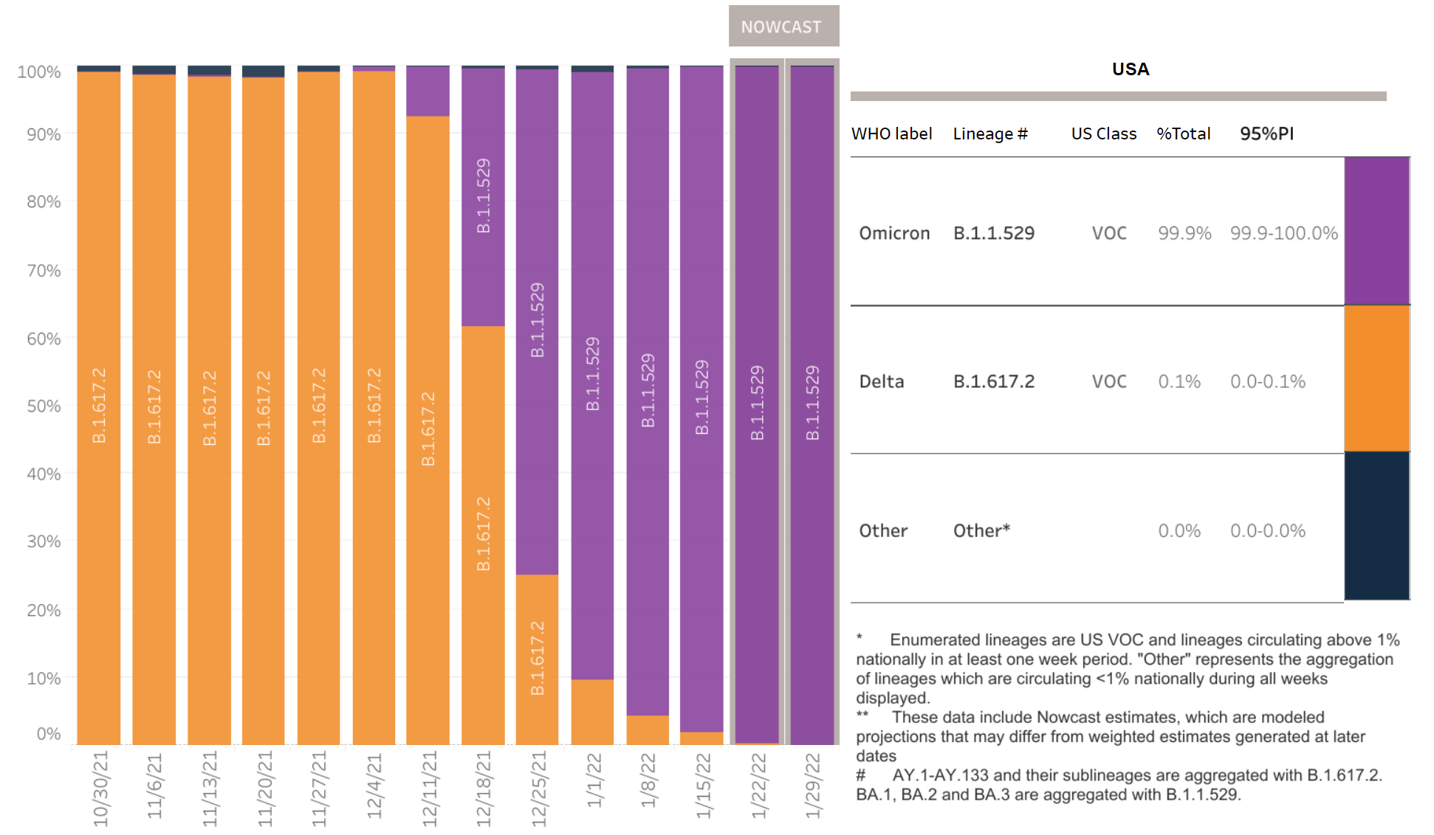
Omicron has replaced Delta as the predominant variant in the United States.
1
https://covid.cdc.gov/covid-data-tracker/#variant-proportions
Notes:
First: As I am sure most of you are aware, Omicron has replaced Delta as the predominant variant circulating in the United States
This figure, with each bar being a 1-week period, shows how rapid and how complete that replacement was—as the orange (representing delta) gives way to purple in December and January.
At this point, I want to point out that the purple includes 3 sublineages of Omicron (BA. 1, .2, .3). You’ve probably heard more and more about BA.2 recently, and we’ll come back to it in a moment.

Slide 9
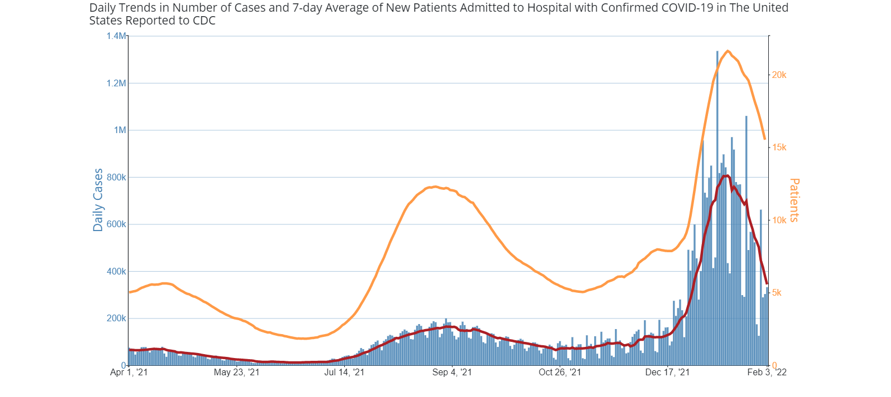
U.S. COVID-19 cases and hospitalizations are declining.
2
New cases (7-day moving average)
New hospitalizations (7-day moving average)
https://covid.cdc.gov/covid-data-tracker/#trends
Notes:
Number 2: After setting new records at the height of this Omicron surge, U.S. COVID-19 cases and hospitalizations are now declining. Here, red line shows the 7-day moving average of cases, and the yellow line shows the 7d moving average of new hospitalizations.
While the shape of the curve is looking promising, we still have a ways to go with both daily cases and hospitalizations above the levels we saw during Delta.
“The blue bars show daily cases. The red line is the 7-day moving average of cases. The orange line represents the 7-day average of the number of inpatients (adult and pediatric) admitted to a hospital with confirmed COVID-19 diagnosis.”

Slide 10
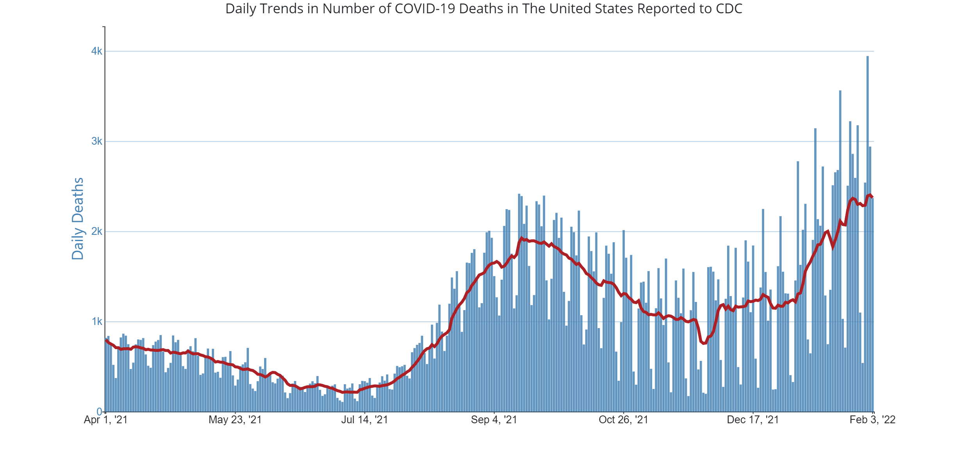
U.S. COVID-19 deaths have risen in recent weeks.
3
https://covid.cdc.gov/covid-data-tracker/#trends
Notes:
Despite all of that, given the sheer number of new cases due to Omicron over the past few weeks in the United States, we are now seeing a rise in daily reported deaths, now up above 2.000 per day and climbing.
These deaths, which lag behind cases and hospitalizations by a couple of weeks, are a reminder that while Omicron might be milder than prior variants, it is not truly mild
Especially not for the hundreds of thousands who do require hospitalization during this period or for the tens of thousands who die.

Slide 11
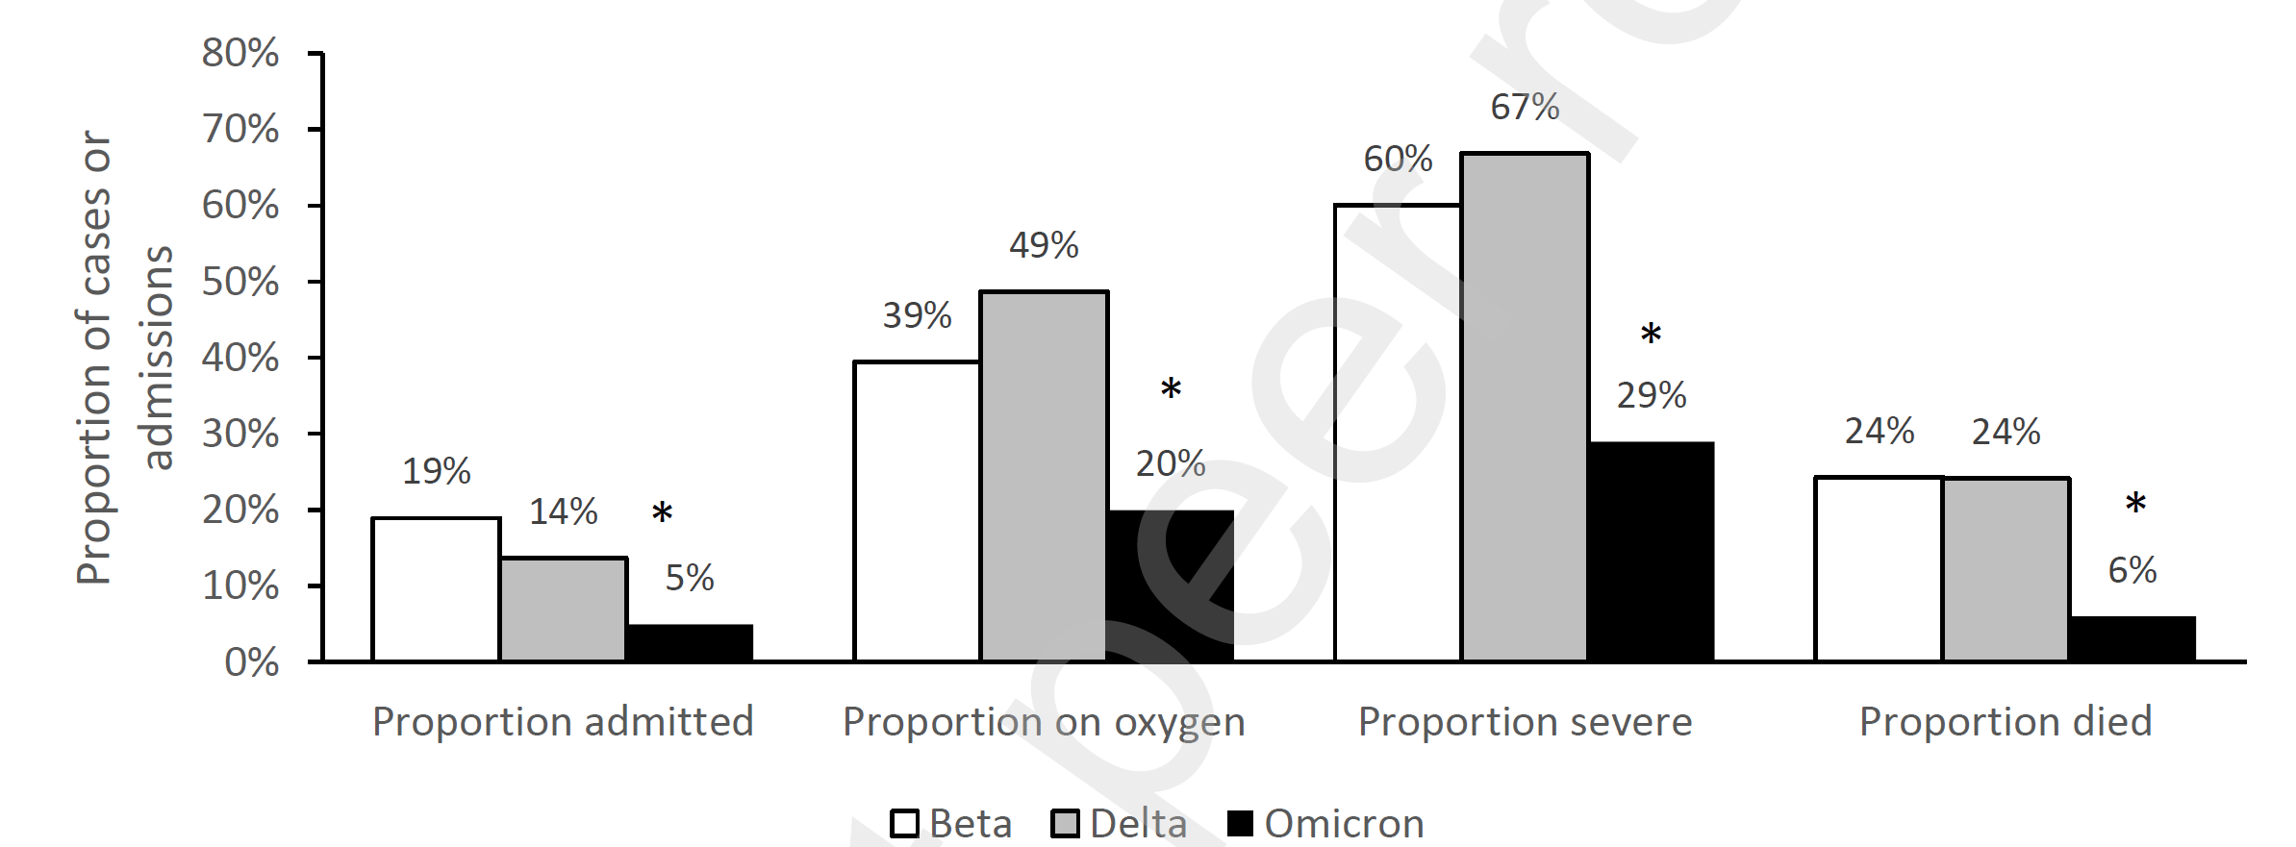
Disease severity appears to be lower for Omicron than for Delta.
4
* Indicates statistically significant difference
Data from Gauteng Province, South Africa; figure from Jassat et al, SSRN
Notes:
In South Africa, where the Omicron variant was first widely detected, researchers found that:
During the Omicron period, 5% of cases were admitted to the hospital (much lower than for Delta or Beta)
For those who were admitted, fewer required oxygen and fewer met criteria for severe disease
And overall fewer died—just 6% of those admitted to the hospital compared to 24% for Delta and Beta.
But why is that? Is it because Omicron is truly milder? Or perhaps that more people had some amount of protection from vaccination or from prior infection?
Pattern of reduced severity has held up Substantial

Slide 12
mRNA vaccine effectiveness (VE) is lower for symptomatic infection due to Omicron compared to Delta.
5
Delta
Omicron
SARS-CoV-2 variants of concern and variants under investigation (publishing.service.gov.uk)
Notes:
Data from the UK show that Pfizer mRNA vaccine effectiveness is lower for infections due to Omicron compared to Delta.
In this figure, the black squares represent VE for Delta and the grey circles represent the VE for Omicron.
You can see that for each time point on the x-axis, which is the number of weeks after vaccination, Omicron VE is lower than for Delta
The difference is especially large for those who completed a 2-dose series weeks or months ago
After about 15 weeks, VE drops to below 20%
A Pfizer or Moderna mRNA booster restores protection from infection back up to initial levels, though as you can see here, some waning from the booster can be seen again starting a month or so after.

Slide 13
mRNA vaccine effectiveness (VE) is lower against hospitalization for Omicron compared to Delta.
6
Delta
Omicron
UK Health Security Agency: Vaccine Surveillance Report, Week 5
Notes:
https://assets.publishing.service.gov.uk/government/uploads/system/uploads/attachment_data/file/1052353/Vaccine_surveillance_report_-_week_5.pdf

Slide 14
Clinical presentation may differ for Omicron compared to Delta.
7
UK Health Security Agency: Technical briefing 34
Notes:
Figure 10 shows a forest plot of adjusted odds ratios of symptoms being reported by Omicron cases compared to Delta cases during the month of December. Sore throat was more likely to be reported by cases with Omicron (53% of Omicron cases, 34% of Delta cases, odds ratio 1.93, 95% CI: 1.88-1.98). On the other hand, loss of smell and taste was found to be less common among Omicron compared to Delta cases (13% of Omicron cases, 34% of Delta cases, odds ratio 0.22, 95% CI: 0.21-0.23).
Odds ratios adjusted for: age group, sex, ethnicity, self-reported vaccination status, region of residence, and week of symptom onset

Slide 15
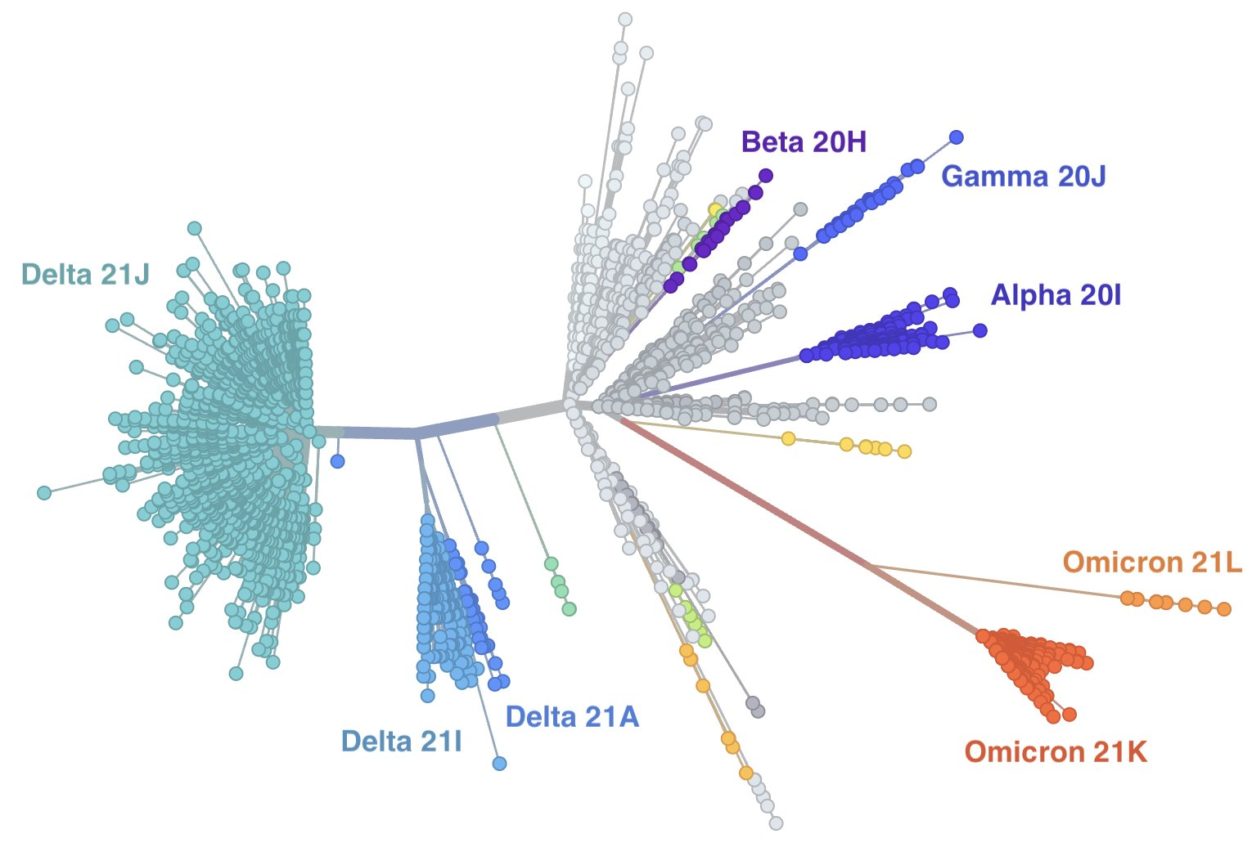
BA.2 is growing quickly in some countries.
8
https://nextstrain.org/ncov/gisaid/global?l=unrooted&m=div
Notes:
Tree comprised of sequences uploaded from around the world

Slide 16
BA.2 is growing quickly in some countries.
8
Notes:
Tree comprised of sequences uploaded from around the world

Slide 17
Early evidence suggests BA.2 is more transmissible than BA.1.
9
BA.2
BA.1
Transmission of SARS-CoV-2 Omicron VOC subvariants BA.1 and BA.2: Evidence from Danish Households: Lyngse et al, medRxiv

Slide 18
Questions remain about the characteristics of BA.2.
10
Severity
Vaccine effectiveness
Impact on therapeutics
Rate of reinfection

Slide 20
Disclosures:
Nothing to Disclose
Implementing Outpatient
Treatment: Emory University
Zanthia Wiley, MD

Slide 21
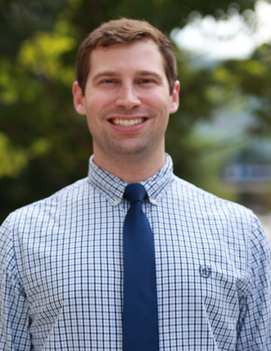
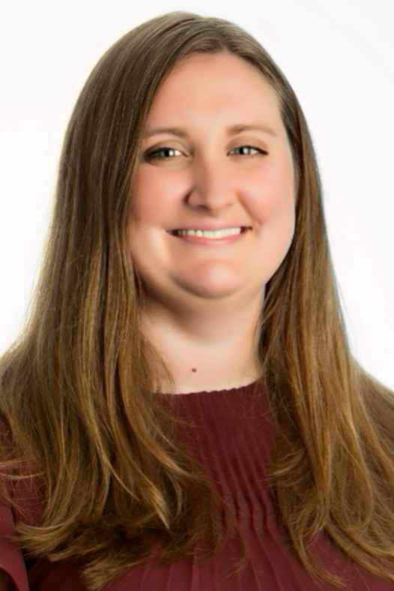
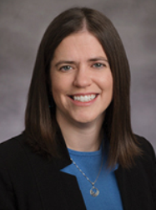
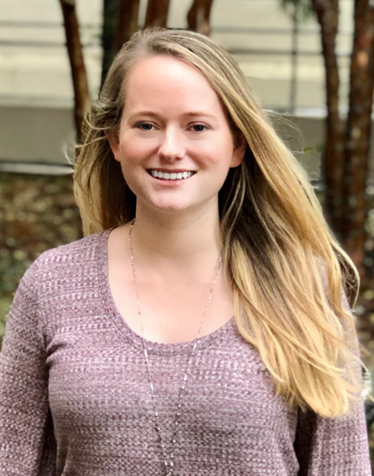
Outpatient COVID-19 Therapeutics
Zanthia Wiley, MD
Director of Antimicrobial Stewardship
Emory University Hospital Midtown
Associate Professor of Medicine
Division of Infectious Diseases
Benjamin Albrecht, PharmD
ID Clinical Pharmacy Specialist
Emory University Hospital
Sarah Green, PharmD
ID Clinical Pharmacy Specialist
Emory University Hospital
Marybeth Sexton, MD
Director, Antimicrobial Stewardship, CQO PGP, Clinic Epidemiologist Emory University Hospital
K. Ashley Jones, PharmD
ID Clinical Pharmacy Specialist
Emory University Hospital Midtown
Zanthia Wiley, MD
Director, Antimicrobial Stewardship, Emory University Hospital Midtown

Slide 22
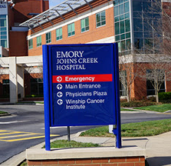
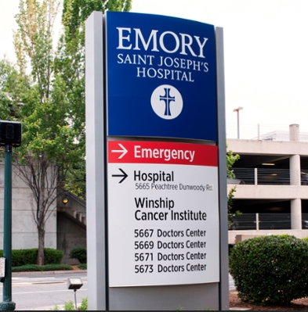
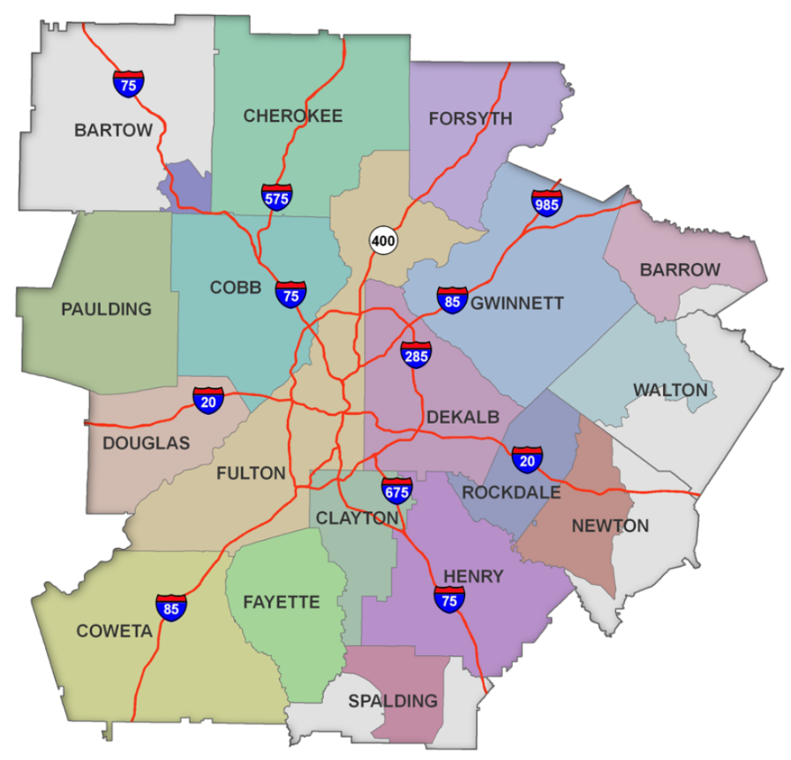
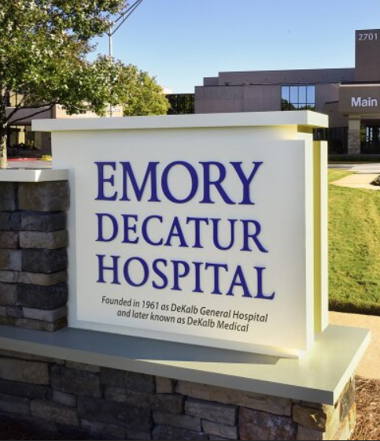
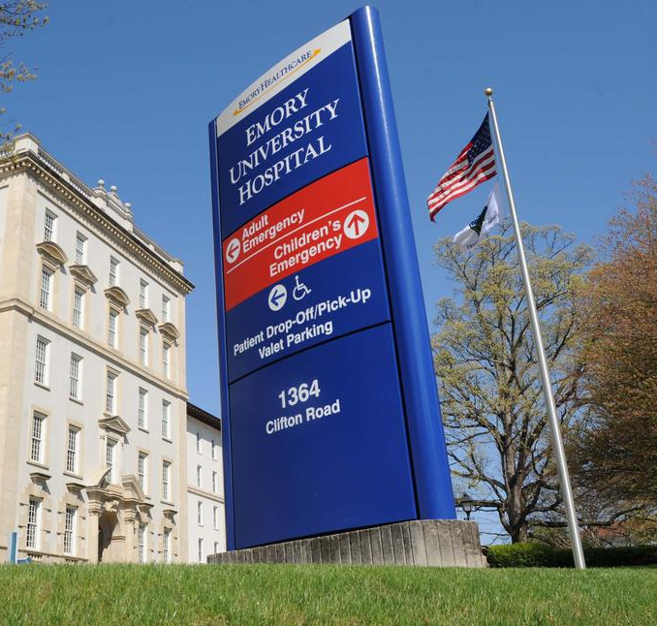
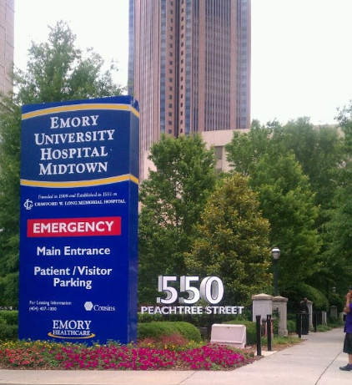
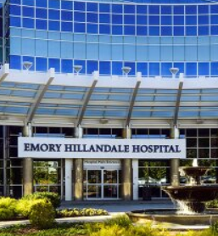
The Communities We Serve

Slide 23
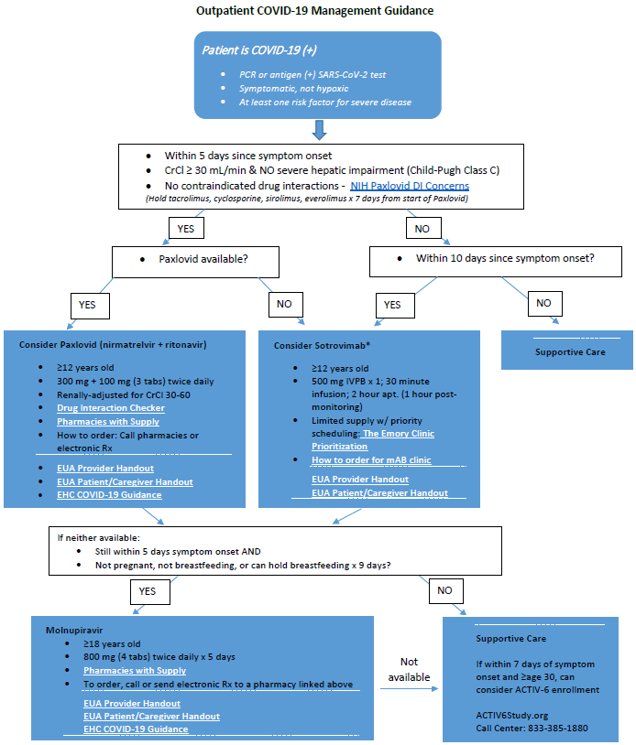
Outpatient COVID-19 Algorithm
Developed by Pharmacy/ID/Quality/Ambulatory
EHC resources + NIH recommendations
Educated via PDF instructions + Outpatient Management Guidance Video Walkthrough reviewing instructions

Slide 24
Nirmatrelavir/ritonavir (Paxlovid)
& Molnupiravir (Lagevrio)
12/22/21 - Nirmatrelvir/ritonavir granted EUA
12/23/21 - Molnupiravir granted EUA
12/23/21 - NIH updates guidance for outpatient tx/PrEP
12/24/21 – IDSA new recommendation on use of nirmatrelvir/ritonavir
12/30/21 – IDSA new recommendation on use of molnupiravir

Slide 25
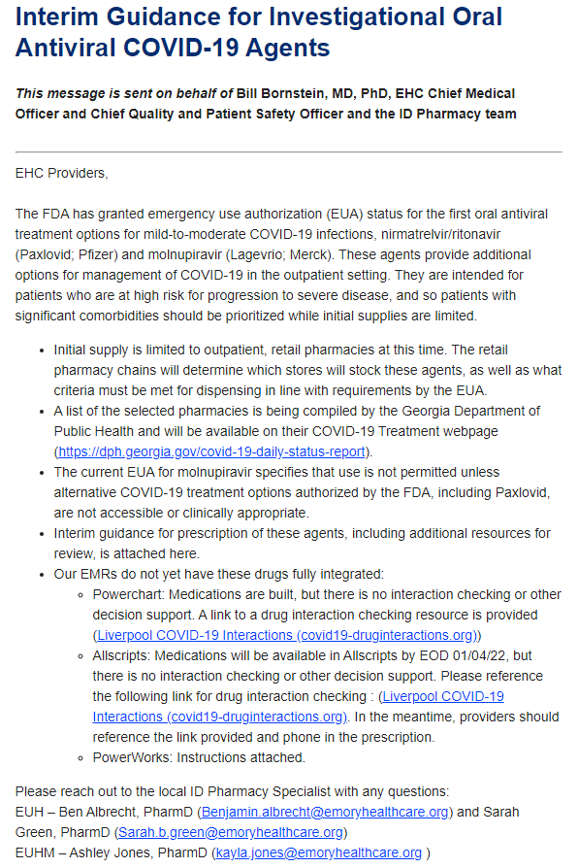
Integrate leadership early
January 5
Direct link to pharmacies
Drug interaction checker
Contacts for Questions

Slide 26
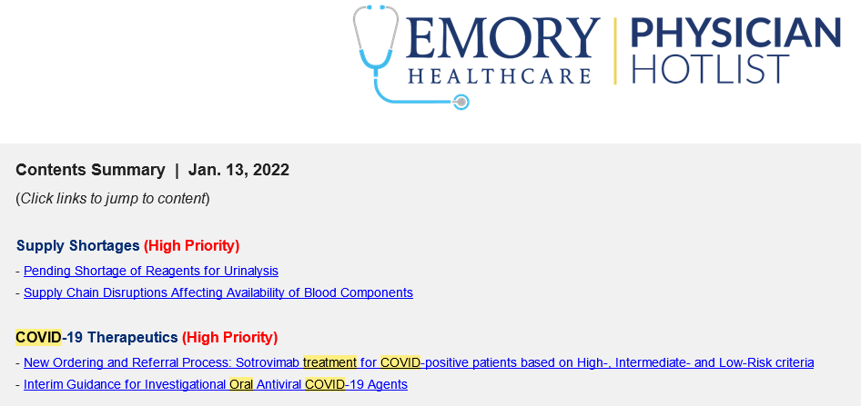
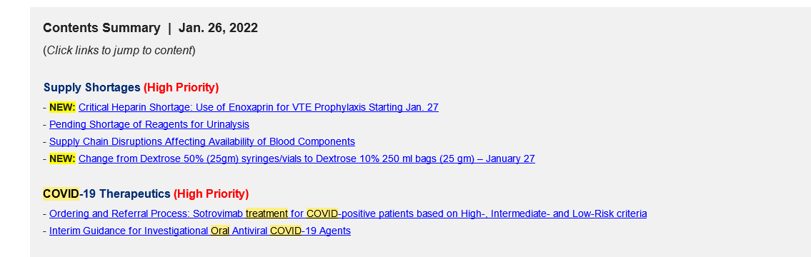
Frequent electronic communication
Benjamin Albrecht, PharmD
ID Clinical Pharmacy Specialist
Emory University Hospital

Slide 27
Tixagevimab/Cilgavimab
(EVUSHELD)
12/8/21 - Tixagevimab/cilgavimab granted EUA for COVID-19 PrEP

Slide 28
Tixagevimab/cilgavimab Supply
The number of EHC patients who met EUA criteria for tixagevimab/cilgavimab vastly surpassed the supply
  Additional prioritization for patients at highest risk for severe COVID-19 would not sufficiently meet demand
Subject matter expert (SME) group developed – ID MDs/PharmDs, Pharmacy Leads, CQO Emory Clinic, CMO Emory Clinic, Transplant/Heme/Onc, Allergy/Immunology, etc.
  Prioritization Criteria
  Equitable distribution → Triage Committee → Lottery Process

Slide 29
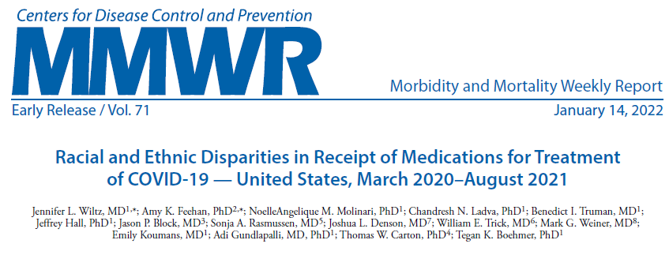
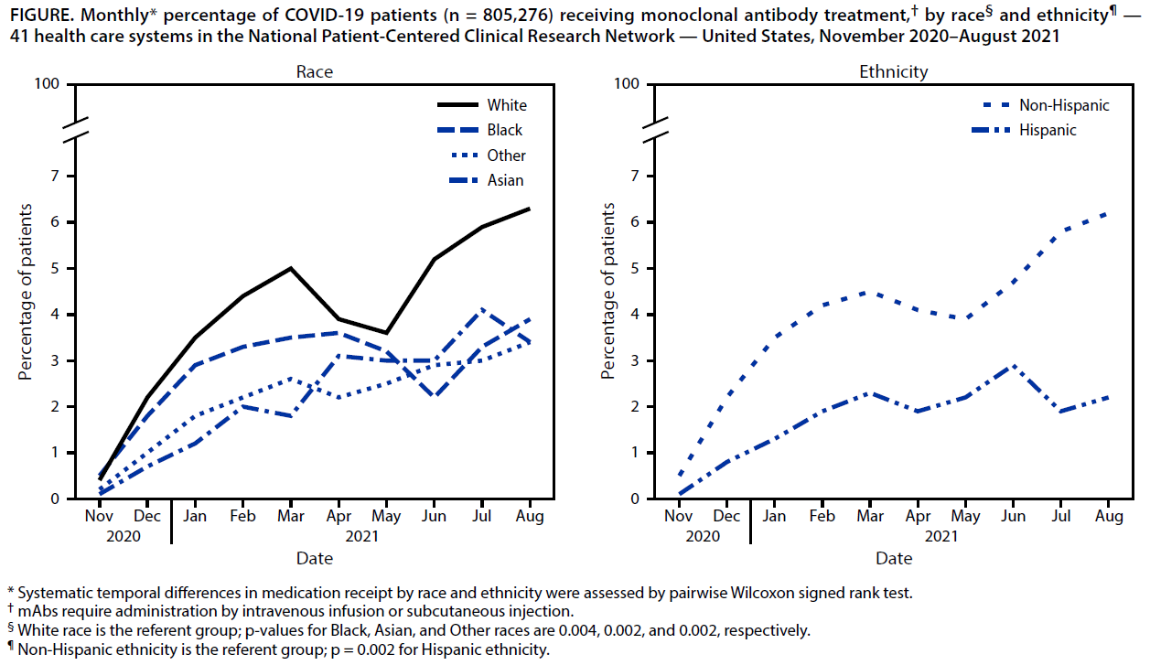

Slide 30
Prioritization and Lottery Timeline
12/22/21: Initial meeting of EVUSHELD Subject Matter Expert (SME)group
  12/23/21: NIH guidance for Prioritization of Outpatient Therapies
1/3/22: Presentation of EVUSHELD to Formulary Stewardship Committee
  1/5/22: NIH guidance for EVUSHELD as COVID-19 Pre-exposure Prophylaxis
1/6/22: Second meeting of EVUSHELD SME group
1/10/22: Initial review by Triage Committee (clinical criteria/equity/lottery)
1/13/22: Final meeting of EVUSHELD SME group/IT involvement
1/18/22: Final review by Triage Committee (FAQ site/randomization method)
1/20/22: Communication emails sent to > 12,000 patients who met criteria
1/21/22: First Lottery/Randomization
1/22/22 (Saturday): First EVUSHELD dose administered
Sarah Green, PharmD
ID Clinical Pharmacy Specialist
Emory University Hospital

Slide 31
Lottery Process
Lists of eligible high-risk patients per EHC criteria generated by specialty practices (Hem/Onc, Transplant, Rheum, Neurology, ID, GI, Derm, Allergy/Immunology)
Patients on the lists sent self-screening tools via patient portal (email)
Eligible patients randomized weekly (random number function/cut-off based on numbers of available doses/lottery re-run with each allocation)
Selected patients sent instructions for scheduling

Slide 32
Messaging to the Patient
Based on answers to the screening questions, patients will get one of 6 messages:
  They qualify and will be entered into the lottery
  They may qualify but need to schedule antibody testing
  They may qualify but their provider needs to review their medical history
  They do not currently qualify based on medical history
  They do not currently qualify based on vaccination status
  They are currently declining to be considered but should notify their provider if they change their mind
Notes:
Antibody testing - If negative, qualifies, will be added to randomization pool; If positive, does not qualify at this time; If not yet tested, will be given instructions for testing

Slide 33
Lottery Process Equity
All eligible patients receive message re: eligibility for tixagevimab/cilgavimab
A list of patients who did not open message shared with clinicians who may fill out the questionnaire for pts (e.g. low health literacy, language barriers, etc.)
Letters will be sent to a patient’s home if messages not open
List compiled with lottery re-run each time we get a new allocation of supply

Slide 34
Scheduling/Administration
Patients selected in the lottery contacted to schedule
Target - schedule all appointments within 7 days
  Want to ensure we use that week’s allocation so that we get resupplied
  Want to encourage qualifying patients to get this as soon as possible
Patients who do not have availability within ~1-2 weeks will be reentered into lottery system
Oncology/transplant infusion clinics, ID clinic, other specialty clinics

Slide 35
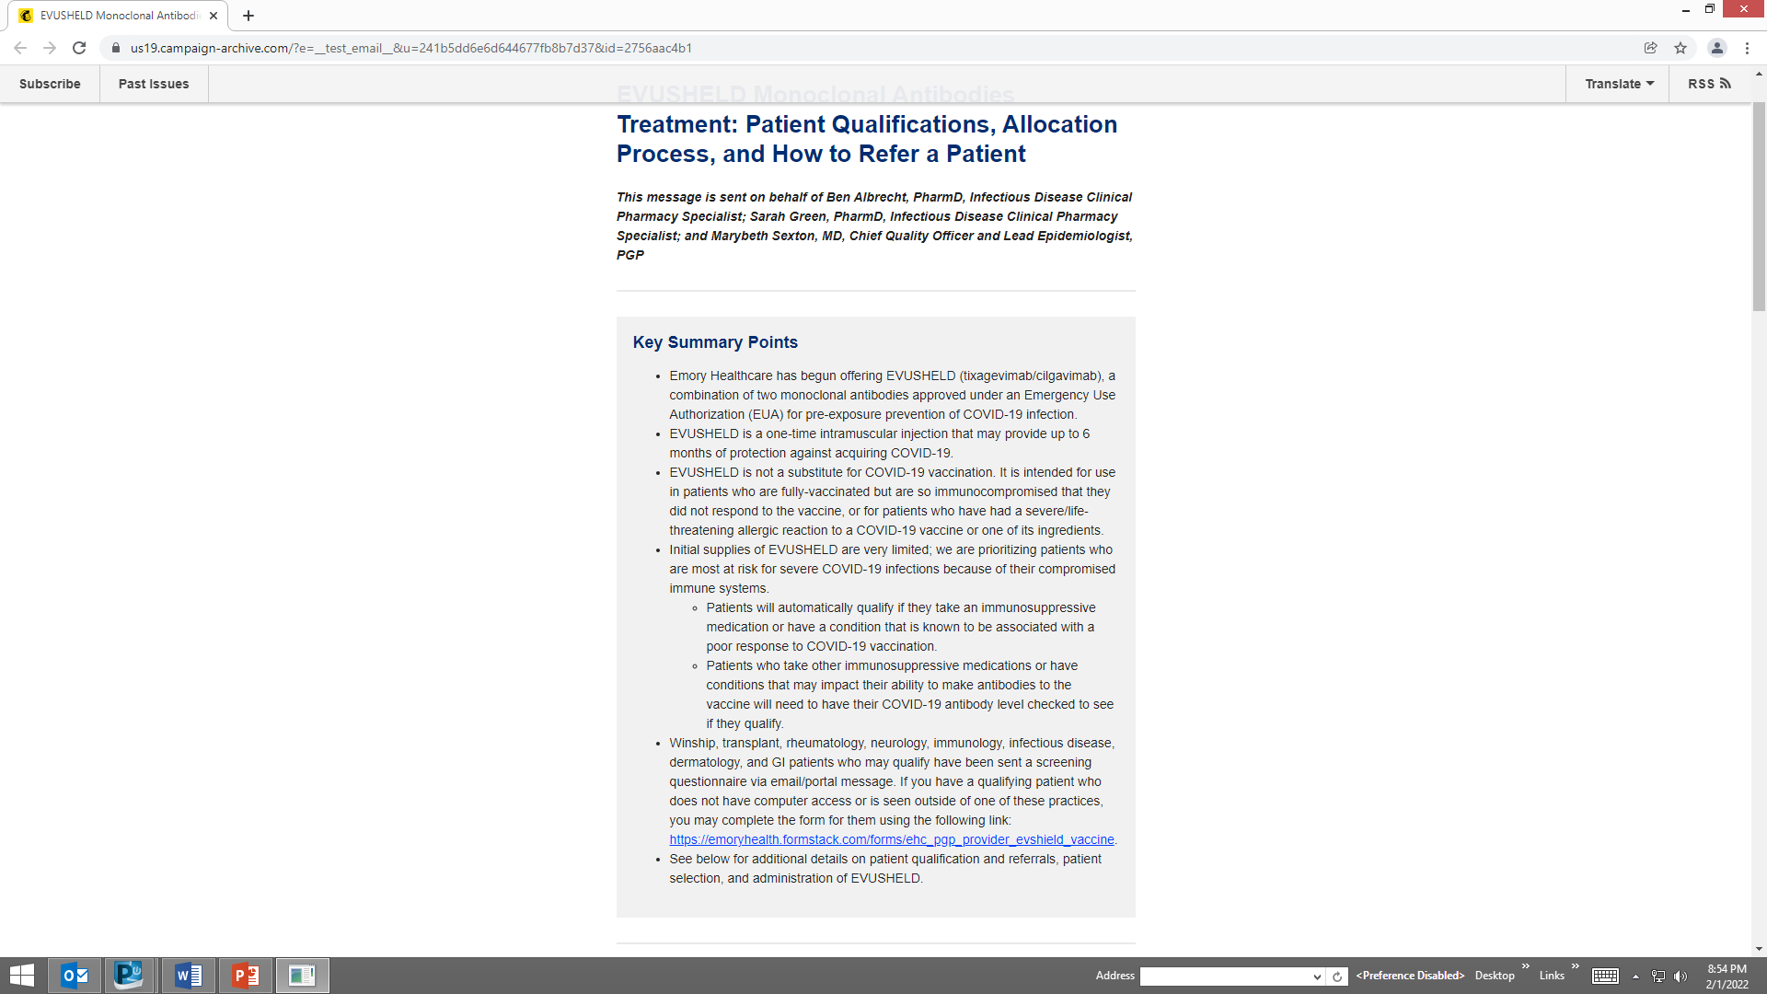
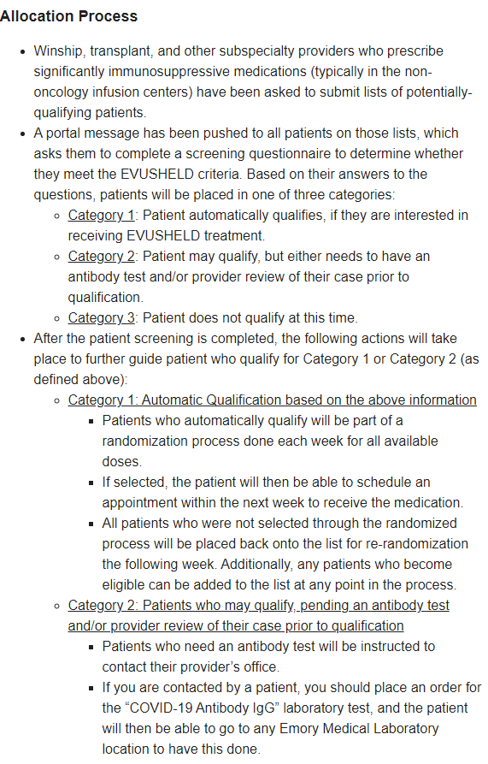
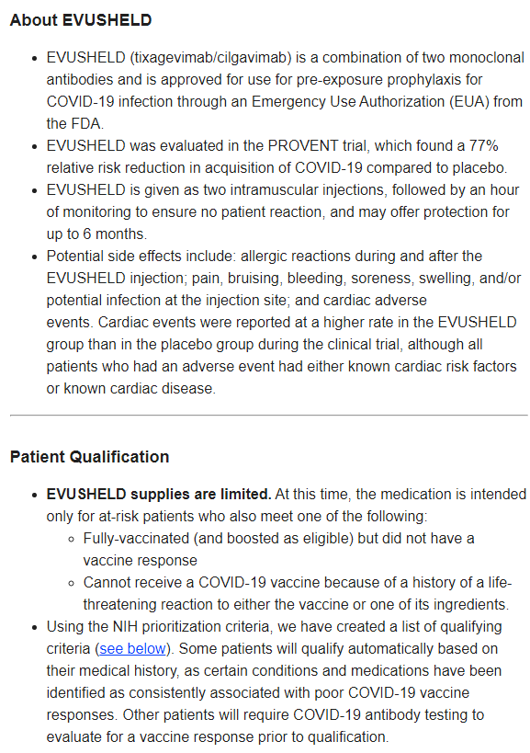

Slide 36
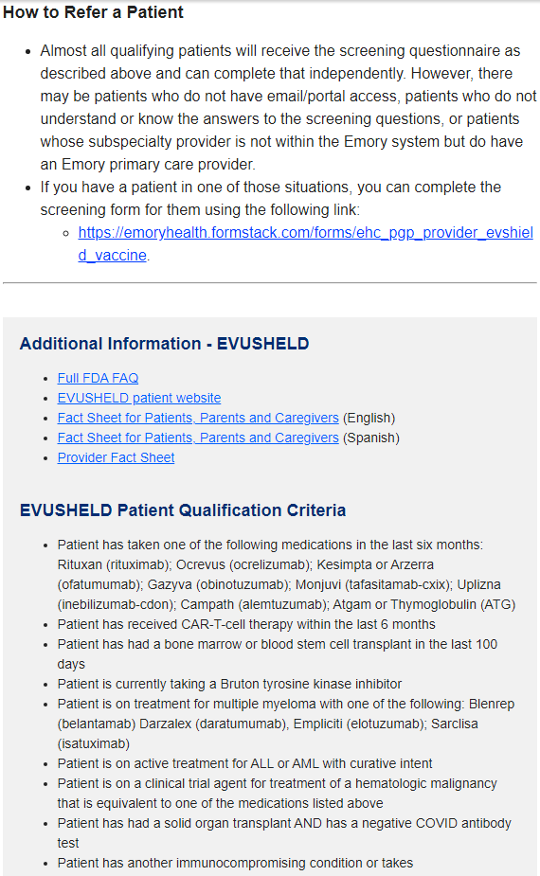
Help for pts who cannot complete independently
Spanish documents

Slide 37
Key Takeaways
Equity is Paramount - intentional, targeted discussions
Involve stakeholders early – ID MDs/PharmDs, Heme/Onc, Transplant, Subspecialty clinic leads, Triage Committee, Healthcare and Clinic Leadership (CMO/CQO)
IT involvement – electronic order entry changes, communication with providers and patients
Don’t reinvent the wheel – CDC/IDSA calls, IDSA Guidance, NIH Guidance, and access the slides/references

Slide 38

Timeline of Teamwork
12/8/21 - Tixagevimab/cilgavimab granted EUA for
COVID-19 PrEP
12/22/21 - Nirmatrelvir/ritonavir granted EUA
12/22/21 - PINETREE study for early, 3-day remdesivir published
12/23/21 - Molnupiravir granted EUA
12/28/21 - EHC begins utilization of 3-day remdesivir option
1/5/22 – EHC releases interim guidance for PO meds
1/20/22 - EHC begins tixagevimab/cilgavimab lottery
1/22/22 – EHC administers first dose of tixagevimab/cilgavimab
Sarah Green, PharmD
Emory University Hospital
Ben Albrecht, PharmD
Emory University Hospital
K. Ashley Jones, PharmD
Emory University Hospital Midtown
Marybeth Sexton, MD
Director, Antimicrobial Stewardship, Emory University Hospital
Zanthia Wiley, MD
Director, Antimicrobial Stewardship, Emory University Hospital Midtown

Slide 39
Disclosures:
Nothing to Disclose
Reaching Underserved Patients:
Grady Health System
Sheena Kandiah, MD, MPH

Slide 40
Reaching Underserved Patients: Grady Health System
Sheena Kandiah, MD MPH
Medical Director Antimicrobial Stewardship, Grady Health System
Associate Professor Infectious Diseases, Emory School of Medicine

Slide 41






High Quality Care for All
GRADY IS THE LARGEST HOSPITAL IN GEORGIA WITH
953
LICENSED BEDS
153,000+
PATIENTS TREATED IN THE EMERGENCY DEPARTMENT
MORE THAN
715,000
PATIENT VISITS PER YEAR
6
GRADY NEIGHBORHOOD HEALTH CENTERS
25%
OF ALL GEORGIA PHYSICIANS RECEIVED SOME OF THEIR TRAINING FROM GRADY
MORE THAN
7,200
EMPLOYEES

Slide 42









Community Assets
Industry-leading Marcus Stroke and Neuroscience Center
Georgia Cancer Center for Excellence and Avon Breast Center
911 ambulance service for Atlanta and South Fulton; service provider for 16 rural GA counties
State-of-the-art Correll Cardiac Center
Busiest Level 1 Trauma Center in Georgia – ACS Nationally Certified
One of the country’s largest infectious disease programs
Nationally accredited burn center – 1 of only 2 in GA
World’s first 24-hr comprehensive sickle-cell center
Georgia’s only poison control center

Slide 43



Our Caregivers
Over 1,100 physicians on active medical staff
Over 800 residents/fellow trained annually
Numerous Medical and Nursing students educated annually

Slide 44
Barriers to care
Housing insecurity
Food insecurity
Childcare
Transportation
Poor support system
Low health literacy
Distrust of the medical system

Slide 45

No judgment zone

Slide 46
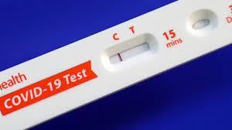
Testing and Vaccines
MIH
Clinics
ED
Community outreach
  Facilities
  Organizations (i.e. sheltering arms, MARTA)
  Nursing home
  Texting/phone calls/

Slide 47

Mobile Integrated Health (MIH)
In home PCR testing
In home follow up visits
In home Vaccine administration
In home Mab administration
Population Health and Strategy – community events
  Senior living facilities
  Vaccine administration at various facilities/organizations
Vivify remote home monitoring program

Slide 48
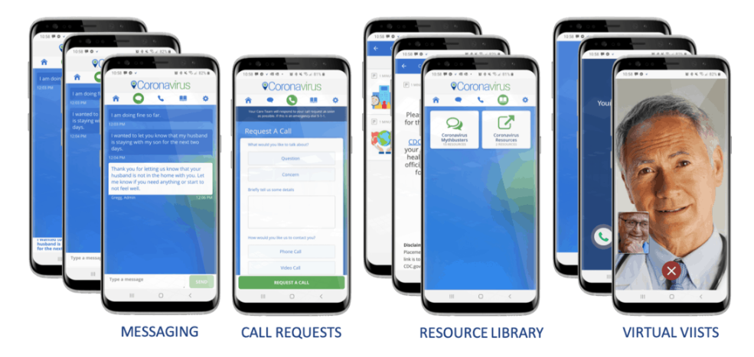
Vivify
VIVIFY RPM
  tablet
  Pulse ox
  BP cuff
2x/day check in
Managed by Grady NPs
Care escalation PRN
Therapeutics consultation where appropriate

Slide 49
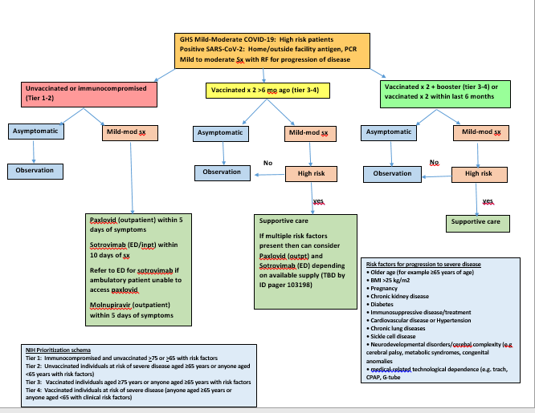
Decision Tree

Slide 50
Oral therapeutics
GHS Mild-Moderate COVID-19 Management Quick Reference (Covid pager 103198)
Paxlovid (nirmatrelvir/ritonavir) | Antiviral CYP inhibitor – may increase the concentration of coadministered drugs Link for drug interactions: https://www.fda.gov/media/155050/download https://www.covid19-druginteractions.org/ Call 404-938-6446 for pharmacy assistance Contraindicated in hepatic failure Contraindicated in eGFR<30 GFR 30-50 2 tabs BID x 5 days GFR >50 3 tabs BID x 5 days Refer to Paxlovid instruction sheet for quick reference for commonly used drugs (located in order set and on GradyNet > Resources > Grady antibiotics > COVID19 management If patient on antiretrovirals for HIV – no change in meds are necessary Avoid use in transplant patients on calcineurin inhibitors | Within 5 days of symptoms Tier 1: Immunocompromised and unvaccinated aged >75 or > 65 with risk factors for progression Tier 2: Unvaccinated individuals at risk of severe disease aged ≥65 years or anyone aged <65 years with risk factors) | Built into order set Step 1: Evaluate patient for eligibility per NIH prioritization schema and EUA criteria (See below) Step 2: Evaluate patient medications for drug interactions (see below for quick reference) https://www.fda.gov/media/155050/download https://www.covid19-druginteractions.org/ Step 3: Evaluate patient renal and hepatic function for dosing adjustments (see below) Step 4: If patient meets all of the above Review patient fact sheet with patient - https://www.fda.gov/media/155051/download Adverse events: dysgeusia, diarrhea, hypertension, myalgia Document consent using .paxlovid Step 5: Paxlovid order set Send to one of the GA DPH designated pharmacies or GHS outpatient pharmacy if and when supply is available - https://dph.georgia.gov/dph-covid-19-guidance Pharmacy availability: https://healthdata.gov/Health/COVID-19-Public-Therapeutic-Locator/rxn6-qnx8/data
Sotrovimab | Monoclonal antibody Inpatient and ED use only If ambulatory patient is immunocompromised, contact COVID pager for assistance pic 103198 to determine eligibility for receiving in ED | Within 10 days of symptoms Prioritized for immunocompromised and Tier 1 and 2 where paxlovid is not an option | Inpatient and ED only Contact PIC 103198 covid pager for assistance Requires EUA consent Patient fact sheet: https://www.fda.gov/media/149533/download Dotphrase: .sotrovimab ID approval required (PIC 103198)
Remdesivir | Antiviral | Tier 1 and 2 and 3 in special circumstances where patient is unboosted with multiple risk factors | Inpatient only Contact PIC 103198 for assistance No consent necessary (off-label use) ID approval required
Molnupiravir | Antiviral For use only when paxlovid, sotrovimab, and Remdesivir are not an option 4 caps BID x 5 days No renal adjustment or drug interactions Do not use in pregnancy Counsel on contraception | Tier 1 and 2 and 3 if unboosted and supplies available | Use order set – Molnupiravir Requires consent (EUA) Fact sheet: https://www.fda.gov/media/155055/download?ftag=MSF0951a18 Documentation: .molnupiravir

Slide 51
Monoclonal Ab/Remdesivir
Tent for IV infusion Bamlanivimab
Regeneron
  Crestview (SNF) – including PEP
  Clinics
  ED
  MIH
  Inpatient
Sotrovimab – ED, Inpatient
Remdesivir – Inpatient only

Slide 52
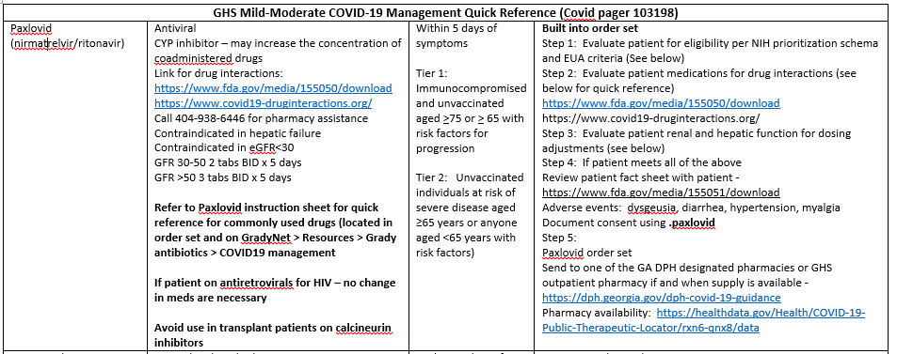
Paxlovid

Slide 53
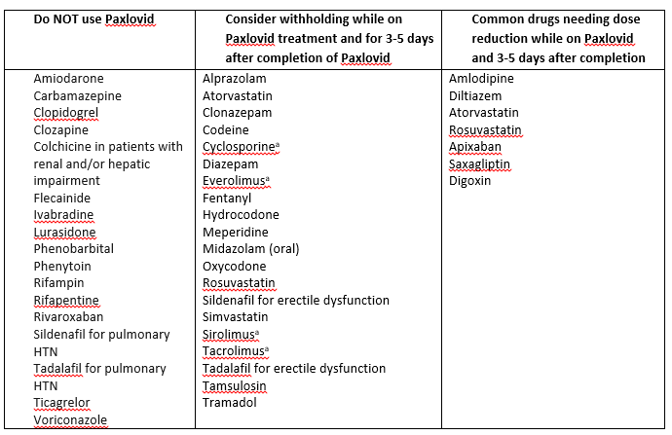
Clinical Decision Support

Slide 54
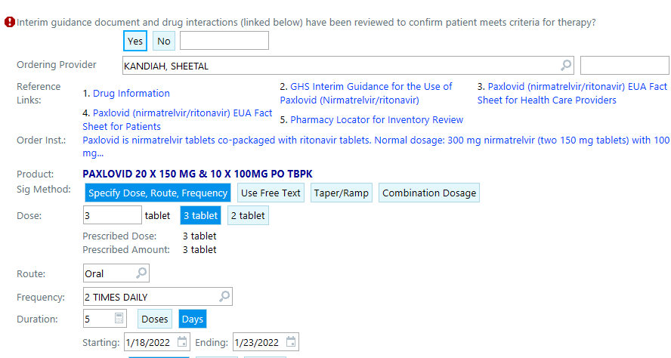
Clinical Decision Support

Slide 55
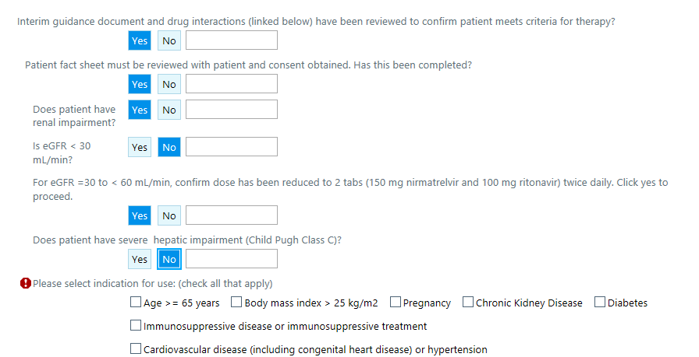
Clinical Decision Support

Slide 56

Summary – It takes a Village
ED
IT
Pharmacy services
ID
Administration
Nursing
All clinical staff
MIH

Slide 57
Acknowledgments
John Haupert, President & CEO
Robert Jansen, MD, Chief Medical Officer
Kelley Carroll, MD, Chief Ambulatory Officer
Michelle Wallace, DNP, RN Chief Nursing Officer
Rondell Jaggers, PharmD, VP of Pharmacy
Shara Mayberry, Director of MIH
Kimberlee Scott, Manager, Patient Navigation
Leslie Marshburn, Executive Director of Population Health
Leigh Reece, Executive Director of Marketing/Communication
Diane Wirth, Vivify Program Manager

Slide 58
Disclosures:
Drs. Heath and Overton: AIDS Clinical Trials Group- COVID Clinical Trials
Dr. Heath: Investigator for Regeneron Trial of REGEN-CoV inpatient trial
Improving Access and Optimizing Delivery at University of Alabama- Birmingham
Sonya Heath, MD & Turner Overton, MD

Slide 59
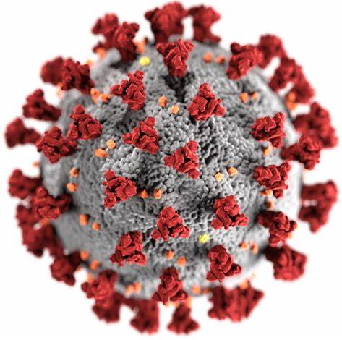
Operationalizing Outpatient COVID-19 Therapeutics: Lessons from the Field:
Improving Access and Optimizing Delivery
Sonya Heath, MD
Turner Overton, MD
University of Alabama @ Birmingham
February 5, 2022

Slide 60
Current Outpatient Treatment Algorithm
80% of patients with COVID-19 have mild illness and do not require medical intervention or hospitalization- Identify HIGH RISK patients
Provide supportive care and educate on isolation
Advise patient about signs/symptoms to contact health care provider
Identify patients with risk factors for progression & determine treatment eligibility
  Oral antivirals- Paxlovid or Molnupinivir
  Monoclonal Ab infusion- Sotrivimab
Progressively symptomatic patients – frequent nursing calls, Pulse oximetry monitoring
  Prioritize patients with dyspnea to assess for worsening respiratory status and volume depletion
  Dyspnea onset usually between day 4-8 of symptom onset

Slide 61
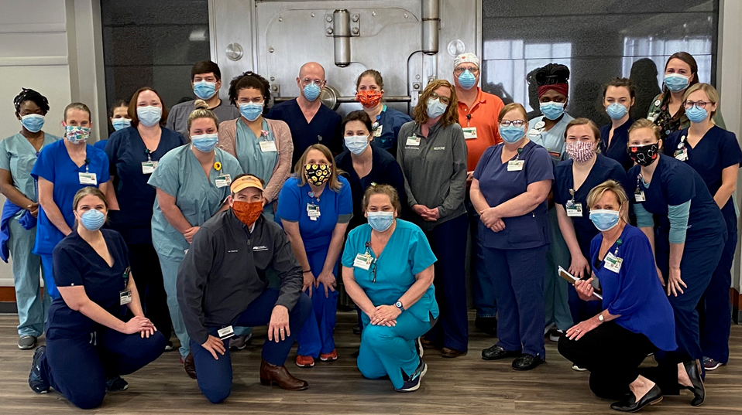
COVID Respiratory Clinic Process
Requires Institutional commitment- dedicated space for COVID Care, Nursing and Admin Staff, MD oversite
PCP performs a phone or video telehealth visit with the patient
Document referral needs/consultation questions
  Persistent Fever, Progressive respiratory symptoms, Volume Depletion
  Lab or CXR only visit
  mAb Infusion
  Remdesivir infusion (soon)
Send message to Access Center COVID Respiratory Pool
  Include Sx onset, Test date, High risk factor, vaccination status
  Centralized nursing to triage, review eligibility, educate providers
  Assess if provider has considered Paxlovid or Molnupinivir (first 5 days since sx onset)
MD present to see patients
  IVF- orthostatic VS on all patients
  Antiemetics
  mAb
  Home Oxygen- 2-minute walk test
  Steroids if persistent fever or hypoxia
  Escalate care

Slide 62
Outpatient Treatment Options
High Risk for COVID Progression
Oral Antivirals
Paxlovid
Molnupinivir
mAb
Sotrovimab

Slide 63
Education Pearls for Oral anti-virals for mild-mod COVID
Paxlovid
-Sx onset- < 5 days
Dosing:300/100mg tab PO BID x 5d
1 or more risk factors for COVID progression
89% reduction in hospitalization
Renal dosing:
  GFR 30-60: 150/100 mg tab PO BID
  GFR <30- do not use
Drug-Drug Interactions w/ Ritonavir
No data in pregnancy
Molnupinivir
Sx onset < 5 days
Dosing -200 mg tabs- 4 tabs PO BID x 5d
1 or more RF for COVID progression
30% reduction in hospitalization
FDA approval vote 7 vs 6
No renal or hepatic adjustment
No data in Pregnancy

Slide 64

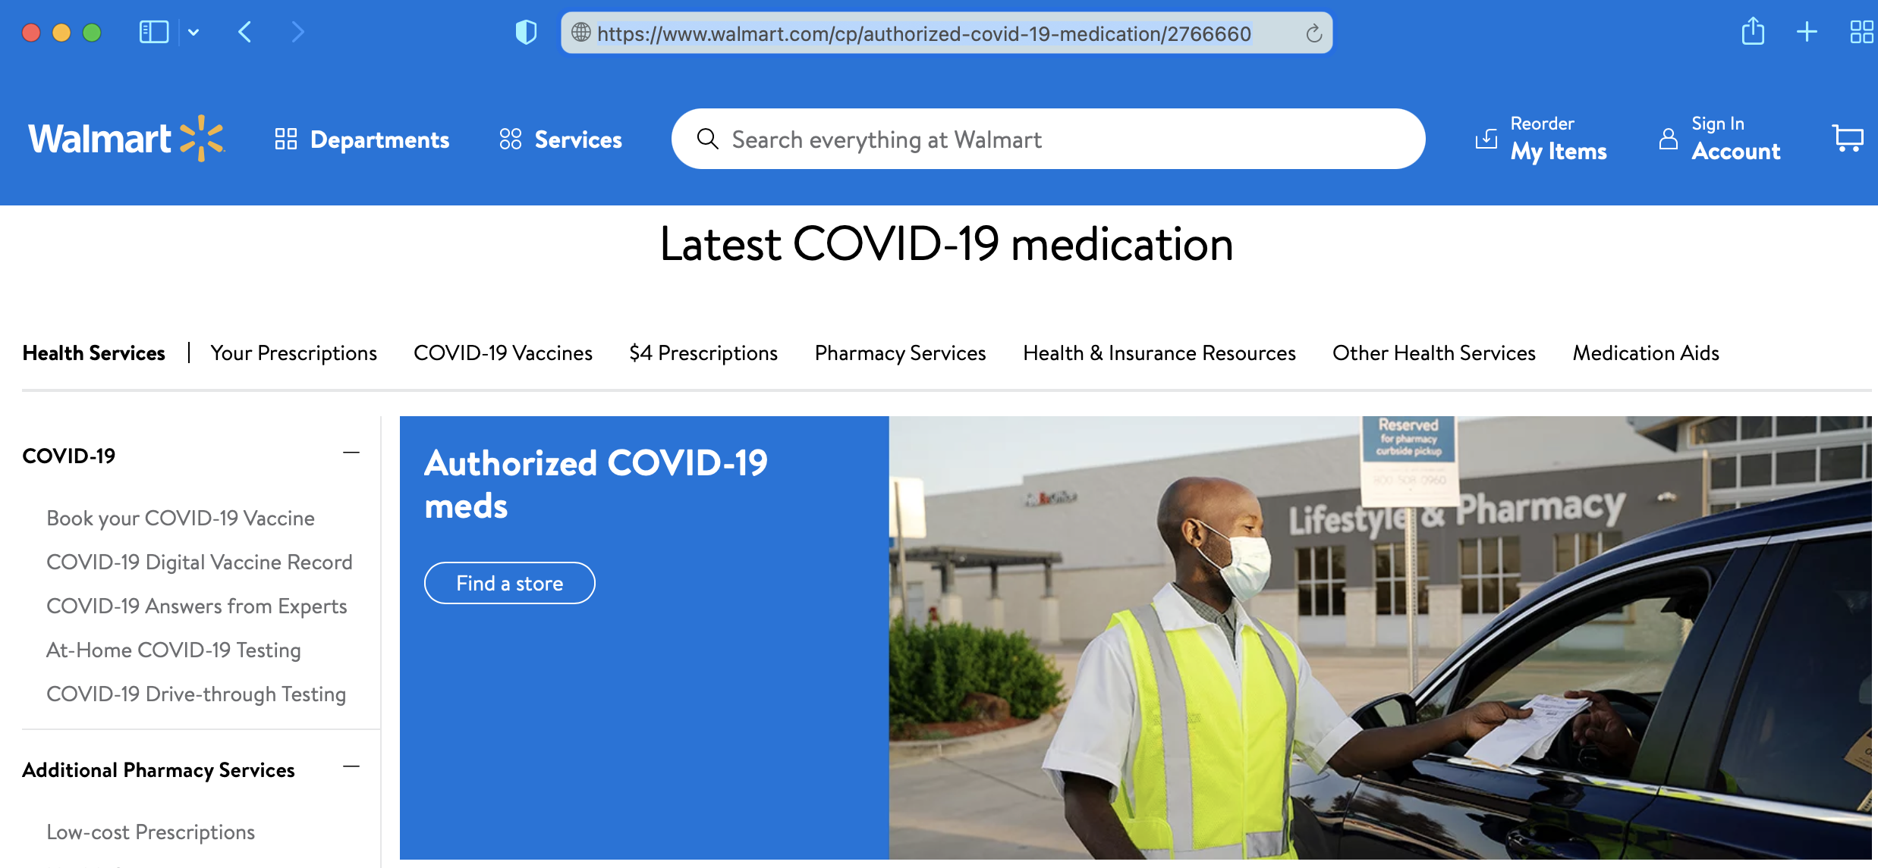
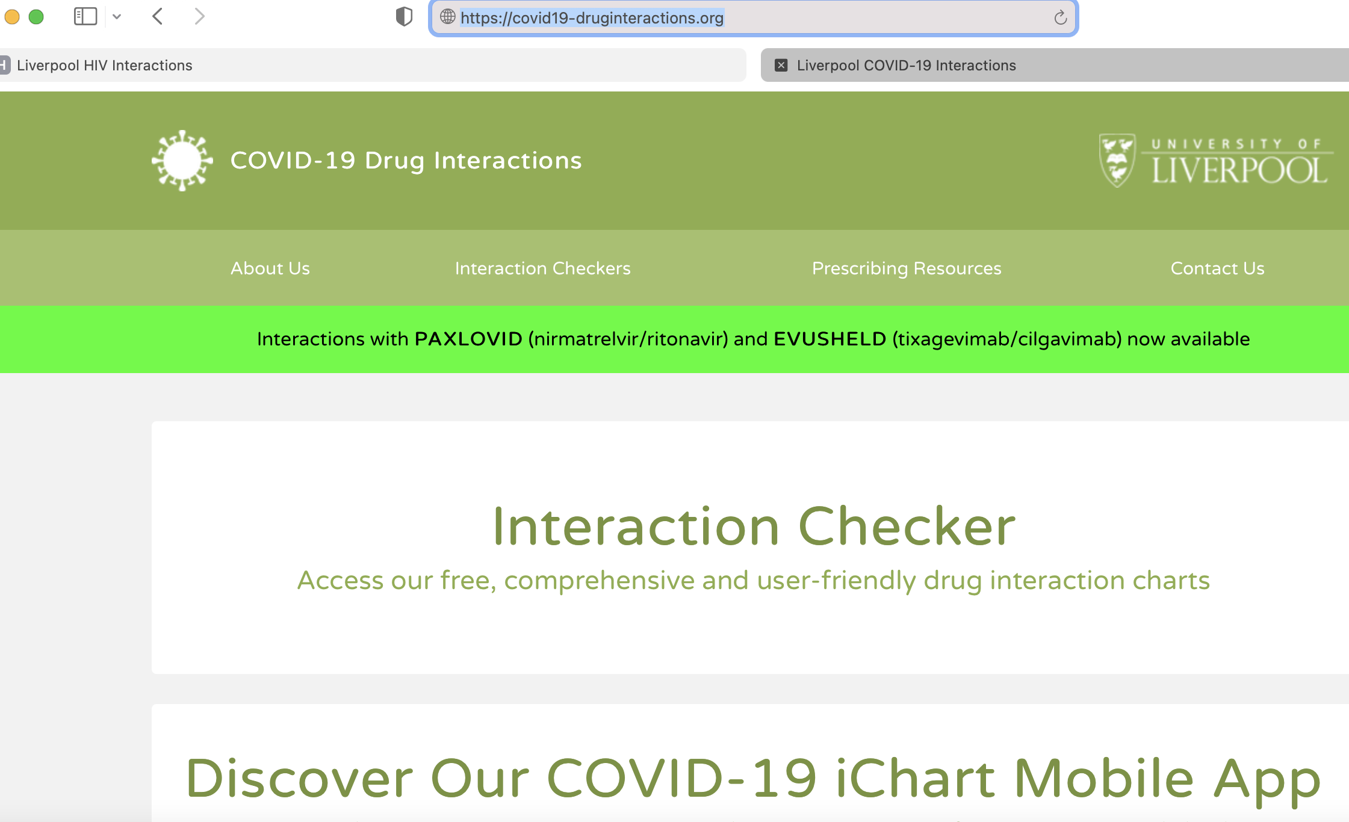
How do I locate and prescribe Paxlovid??
Wal-mart and Sam’s Club- Store Locator
https://www.walmart.com/cp/authorized-covid-19-medication/2766660
University of Liverpool COVID -19 Drug Interactions Database
https://covid19-druginteractions.org
Check GFR
E-Rx and include days since sx onset and risk factor
Call pharmacy- confirm they have it and hold your dose
UAB ONE PAGE –STEP BY STEP

Slide 65
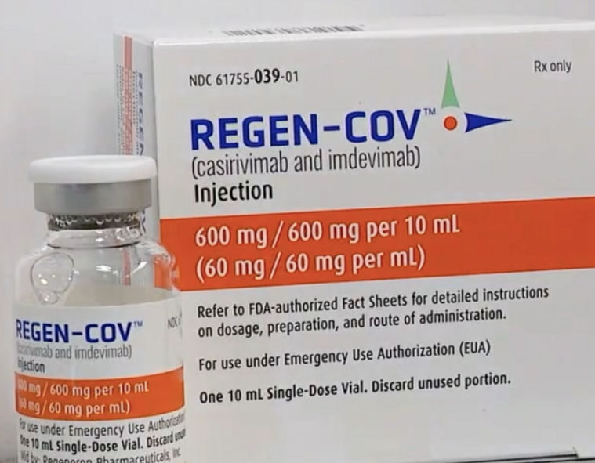
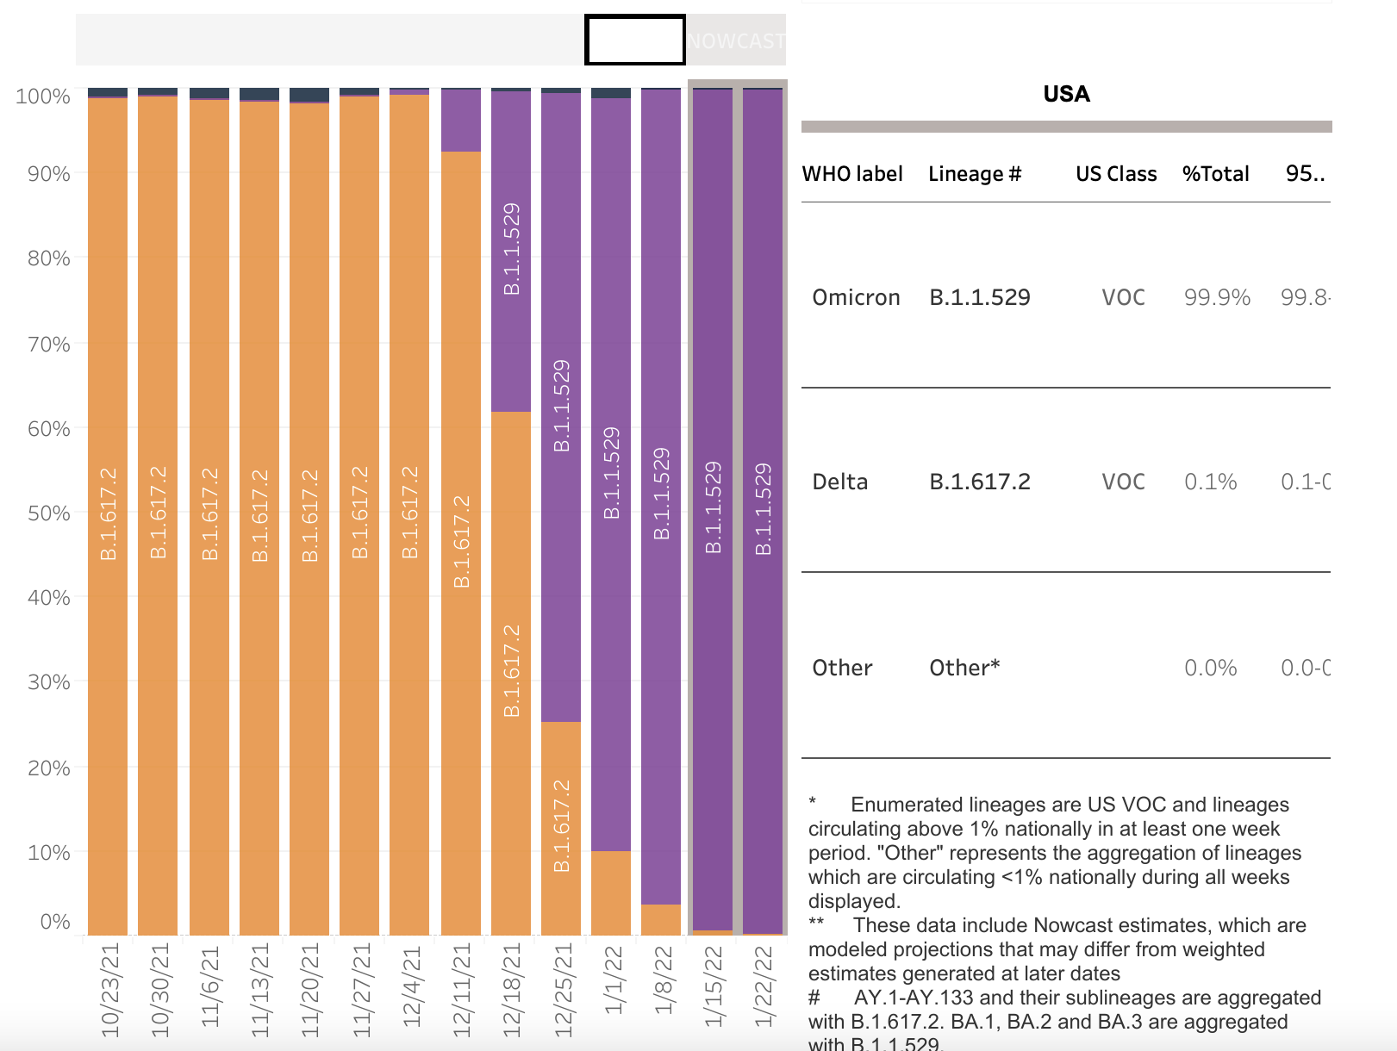
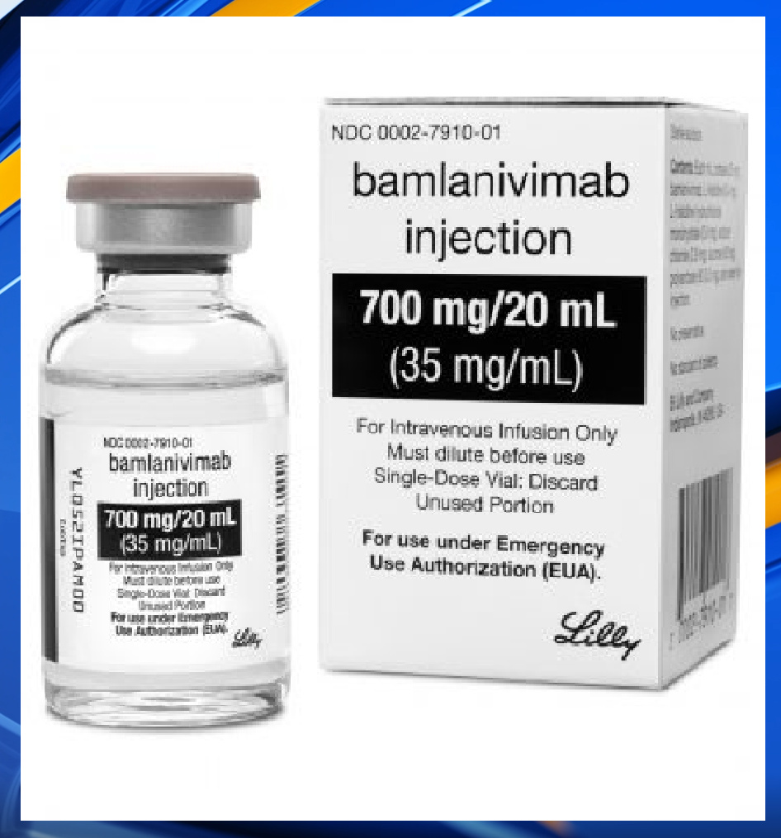
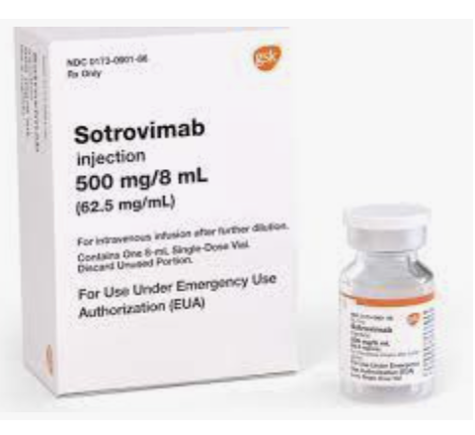
Outpatient COVID Treatment: Neutralizing monoclonal antibodies for the treatment of COVID
VERY limited supply
NOWCAST: Viral Sequence Surveillance

Slide 66
Sotrovimab- Tier 1: < 2 week supply
COVID positive with
High Risk medical condition
< 10 days of symptoms
No
Routine care
Yes
TIER 1
Significant immunosuppression- B cell depleting therapy/ Transplantation/Primary Immunodeficiency
2) Pregnancy- unvaccinated and moderate symptoms
3) Immunosuppression - > 20 mg prednisone/daily or other immunosuppressive agents
Yes
No
Preferred Therapy:
Sotrovimab preferred (< 10 d of sx )
Alternative Therapy:
Paxlovid (< 5 d of sx)
Remdesivir (<7 days of sx, 3 day infusion)
Oral Therapy

Slide 67
Sotrovimab- Tier 2: 2-4 week supply
COVID positive with
High Risk medical condition
< 10 days of symptoms
Tier 1 patients
AND
TIER 2
Tier 2a : Immunosuppression - other immunosuppressive agents
Tier 2b : Unvaccinated with 1 of the following
Age > 65, BMI > 35 , Chronic Lung Disease , Sickle Cell Disease with history of Sickle Chest , Untreated HIV or Advanced disease
No
Yes
Preferred Therapy:
Paxlovid (< 5 d of sx)
  No data in pregnancy
Alternative Therapy:
Sotrovimab preferred (< 10 d of sx )
Molnupiravir (<5 days of sx)
Oral Therapy

Slide 68
Tier Prioritization Systems required for limited supply treatments
Sotrovimab
  mAb unit as available
  4 tiered system
Remdesivir
  mAb unit
  Identified a physician champion in transplant to lead
  Used when Sotrovimab is not available for the highest risk immunosuppressed patients
  Requires a 3 day infusion
Evusheld
  Separate unit for non-covid patients
  Supply not as restricted
  Ordered by primary physician (PCP, H/O, Transplant, Rheum, Allergy/Immunology)
  Scheduled and administered at UAB vaccination site

Slide 69
Disclosures:
Nothing to Disclose
Operationalizing PrEP for Oncology
Patients: Montefiore Medical Center
Amit Verma, MD, FSHEA, FIDSA
Priya Nori, MD, FSHEA, FIDSA
Margaret McCort, MD

Slide 70

PrEP for the Oncology Population at Montefiore
Amit Verma
Priya Nori
Margaret McCort
Montefiore Health System
Albert Einstein College of Medicine
Bronx, NY

Slide 71
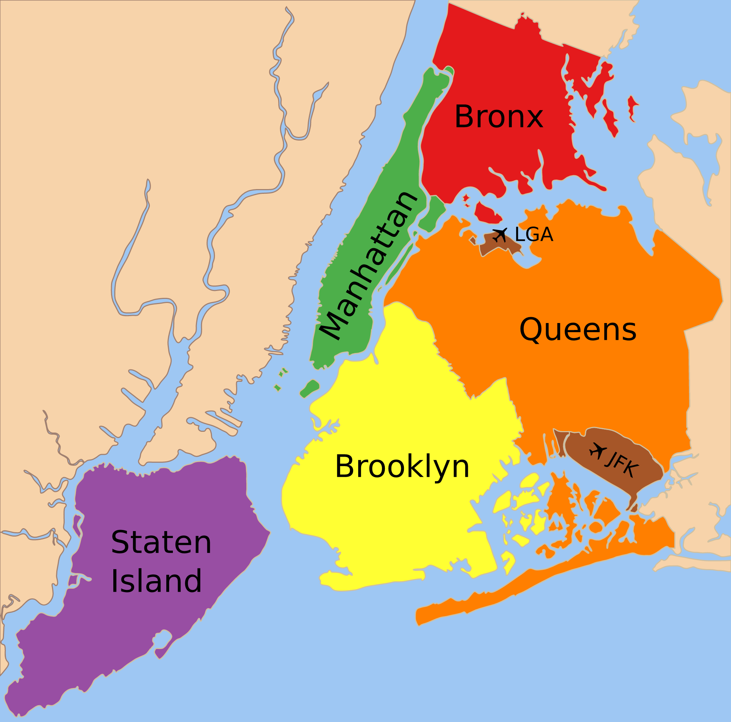
Background
1.435 million residents, 42.47 mi²
30% living below federal poverty level
Majority are covered by Medicare or Medicaid
Montefiore is the largest provider of healthcare in the Bronx

Slide 72
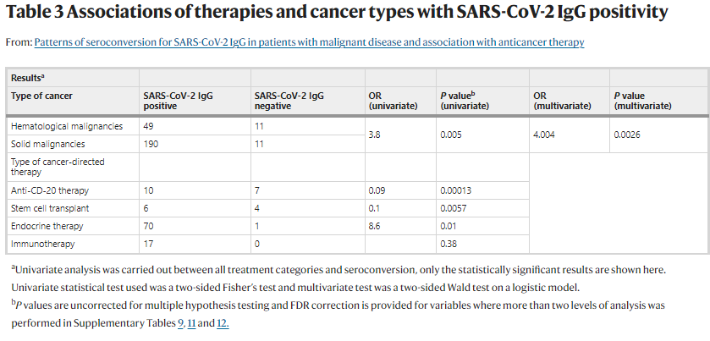
Spike IgG response among cancer patients
Study of 261 patients with cancer (33% heme malignancy, 67% solid) with +SARS CoV2 PCR in prior 90d
  Spike IgG response
    Overall, 92% spike IgG+
    Lower seroconversion:
      Anti-CD20 therapy
      SCT
      CAR-T
Thakkar A, et al. Nature Cancer. Mar 2021.
Notes:
261 patients: 68% (177 of 261) patients had active malignancy and 32% (84 of 261) did not. Median age 64, 44% were asymptoamtic infections
Within 90 days of positive PCR, they underwent SARS-CoV-2 IgG testing and demonstrated a high rate of seroconversion (92%) overall
However, significantly lower seroconversion was observed in patients with hematological malignancies (82%), patients who received anti-CD-20 antibody therapy (59%) and stem cell transplant (60%)

Slide 73
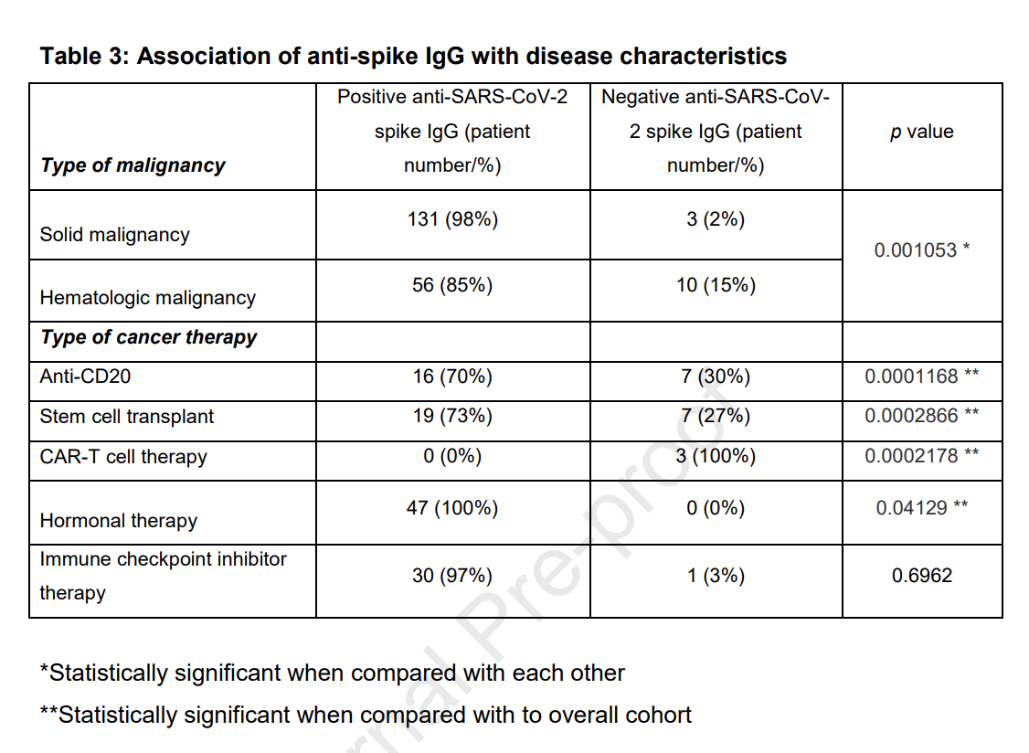
Immune response to vaccination among cancer patients
242 patients with cancer diagnosis who received full vaccine series against COVID-19
  185 patients underwent anti-SARS-CoV-2 spike antibody testing at-least 7 days after completion of vaccine series
  Lower rates of immunogenicity among:
    CAR-T
    SCT
    Anti-CD20 therapy
    Anti-CD38 therapy
  Well tolerated in general
    Sore arm most common AE
Thakkar A, et al. Cancer Cell. Aug 2021.
Notes:
Median age 67, 67% had solid tumor, 33% had hematologic malignancy
22% white, 32% African American, 39% Hispanic, 5% Asian – should we show these Monte demographics at some point?
Only 10% received J&J vaccine- the rest were mRNA 2 doses, and of the mRNA, most were Pfizer

Slide 74
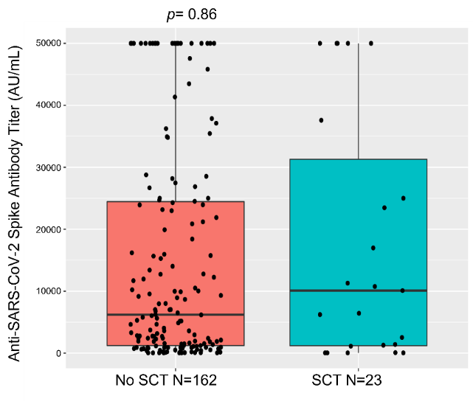
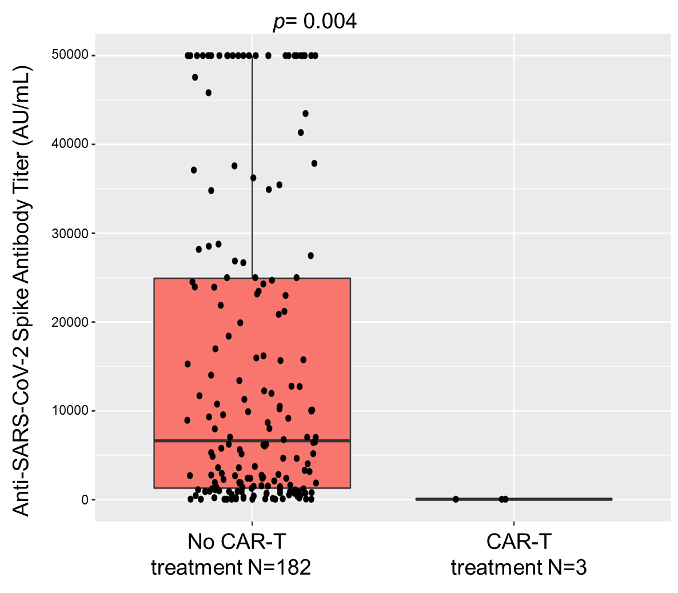
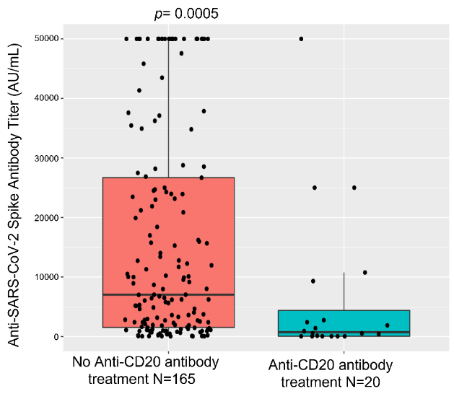
Heme malignancy patients have lower titers post vaccination
Patients receiving transplant, Anti-CD20 and CART therapies lower titers post vaccination
Thakkar A, et al. Cancer Cell. Aug 2021.
Notes:
We included 185 patients who underwent anti-SARS-CoV-2 spike antibody testing at-least 7 days after completion of vaccine series (at the time, this was 2 doses of mRNA or 1 dose J&J)
We studied comparisons in titers by type of malignancy, type of vaccine and different cancer-directed therapies.
Patients who received mRNA vaccines had higher spike IgG titers (not shown), and patients with heme malignancies had lower spike IgG titers than those with solid tumors. When we looked further at the heme malignancy patients, found that certain subgroups had lower spike IgG titers after vaccination: those with history of SCT, those with history of CAR-T, and those who had received anti-CD20 therapy. These populations then are our least likely to have proper response to COVID vaccination and would benefit most from alternative COVID prophylaxis

Slide 75
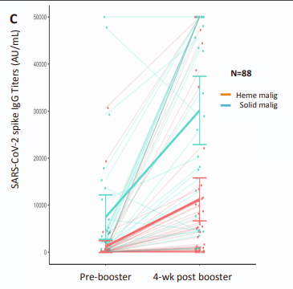

Efficacy of booster vaccine dose in cancer patients
Spike IgG levels wane over time from vaccination
56% with no detectable spike IgG after 2 doses did seroconvert with 3rd dose
Some patients did not form spike IgG even after 3 doses:
  Anti-CD20 within prior 6 mos
Shapiro L, et al. Cancer Cell. Jan 2022.
Notes:
Waning of antibody titers noted 4-6 mos post vaccination, though clinical significance of different titer levels not so clear -

Slide 76
Using local data to inform PreP allocation
Which oncology patients are less likely to develop +spike IgG following natural infection with SARS-CoV-2?
    CAR-T, SCT, anti-CD20
Which patients with cancer are less likely to form immune response with COVID-19 vaccination?
    CAR-T, SCT, anti-CD20
Do booster doses help patients with cancer who did not have positive spike IgG after first doses?
    Yes! Should be prioritized
Notes:
I did not show data on the booster study, but we found that 30% of oncology patients with negative spike IgG after 2 doses of mRNA vaccine formed good response after 3rd dose

Slide 77
Monoclonal Ab Program Evolution
Dec. 2020
Montefiore program inception, DHHS Pilot of 1000 bam doses
1575 Blondell infusion center established (M-F, 8am-6pm)
Jan.–May 2021
Alpha, Iota Surges: 7 days a week/10-12h/day operation in EDs, infusion center, inpatient units
June–July 2021
Ramp down as COVID rates improved and vaccinations increased
July - Sept 2021
Delta Surge: ramp up in all locations, 24/7 infusion capacity in EDs
Dec 2021 – Feb 2022
Unprecedented Omicron surge: pivot from Reg-CoV/Bam-Ete to Sotrovimab
Jan. 2021
January 2022
PrEP for compromised hosts (Tixagevimab/Cilgavimab)

Slide 78

Stewardship “Command Center” for mAb Treatment and Prophylaxis
5 EDs (infusions occur nights/weekends)
Patient self-referrals
COVIDASP@
montefiore.org (8am – 10pm, 7 days/week)
Inpatient
Ambulatory practices
Urgent care centers
Ambulatory Infusion Center M-F, 8-6pm
Notes:
Hype MMC; talk about how existing COVID infusion center was really the best location for patient safety, trained/dedicated staff, and the fact that it is a clean space with private rooms for gluteal admin ot Evusheld.

Slide 79
How it started…
Tier 1 (< 50 doses) | Tier 2 (50-100 doses) | Tier 3 >100 doses
Solid organ transplant (SOT), allogeneic bone marrow transplant (BMT), or CAR-T therapy within the past 2 months SOT recipient receiving lymphocyte depleting agents or reinduction therapy in the past 2 months Receipt of any anti-CD20 agent during the past 6 months | SOT or allogeneic BMT > 2 months from transplant Hematologic malignancies on active chemotherapy CAR-T therapy > 2 months from treatment Primary or secondary immune deficiency (e.g., hypogammaglobulinemia, CVID, etc.) Chronic graft vs. host disease on chronic immunosuppression HIV with CD4<200 | Absolute contraindication for COVID-19 vaccine with note from A/I Solid tumor on active chemotherapy Sickle cell disease or splenectomy Other immunosuppressive agents (e.g., prednisone > 20mg/day or equivalent, TNF alpha inhibitor, proteasome inhibitor, mTOR inhibitor)
How it’s going: more doses than expected; we can treat them as they come
https://covid19treatmentguidelines.nih/gov

Slide 80
Referral Checklist
Patient is in 1 of 3 priority groups
Patient vetted by ID faculty designee; EPIC note completed (.EVUSHELD)
No active COVID-19 symptoms prior to appointment
Negative SARS-CoV-2 PCR or Ag test within 72 hours of infusion appointment
  If home Ag test, administer 1st test 24h prior to & 2nd test morning of appointment
  Demonstration of poor spike IgG response despite vaccination is not required but helps with prioritization
Vaccination:
Prioritization of 4th mRNA vaccine dose followed by PrEP 2 weeks later
  Proof of COVID-19 vaccination with dates
  OR
  Documentation of medical reasons why patient is unable complete COVID-19 vaccinations

Slide 81
Workflow
Onc, SOT, rheum, GI, neuro, derm refers patient to COVIDASP@montefiore.org or ID designee by email
Weekly pt. list sent to ID for vetting, ID contacts patient, completes documentation and arranges for appointment at infusion center
PCR/antigen testing arranged by referring provider within 72h of appointment (Thursday of each week)
Admins batched to Thursday of each week. Staff contacts patient day prior to ensure testing complete and no new COVID symptoms
Patient receives 6 month follow up appointment prior to discharge and contact number in case of breakthrough infection or vaccine questions

Slide 82

Remaining Questions/Challenges
Why is the PrEP demand less than expected?
  Were the majority infected with Omicron?
Recent COVID-19 infection +/- treatment with sotrovimab
  What is the optimal timing of PrEP?
  Both sotrovimab and tixagevimab/cilgavimab are extremely long acting
  90-day vaccine delay removed from CDC/ACIP recommendations
What is the true incidence of cardiac events?
What is the actual efficacy of tixagevimab/cilgavimab against Omicron? (12- to 30-fold reduction in in vitro susceptibility)
  No breakthrough cases reported yet at Montefiore
Notes:
Mention that it has been very well tolerated without any issues so far in terms of adverse reaction. Bottom line is that this agent give secluded/isolated patients a lot of hope. It does have a role but with caveats, and additional vaccine doses remain the priority.
Cardiovascular events: higher proportion of treatment arm patients had MI or cardiac failure, all had prior history of CVD, no clear temporal pattern

Slide 83

Thank You
@IDPeggyM
@Amitvermamds
@PriyaNori
@MontefioreID

Slide 84
Disclosures:
Nothing to Disclose
Administration of Monoclonal Antibody: Real-World Implementation
Anurag Malani, MD, FIDSA, FSHEA

Slide 85
Administration of Monoclonal Antibody: Real-World Implementation
Anurag Malani, MD, FIDSA, FSHEA
Medical Director, Antimicrobial Stewardship, Hospital Epidemiology, Special Pathogens

Slide 86
So, the Story Begins…
December 2020 – First MAB infusion in ED
February 2021 – First MAB home infusion, partnership with local EMS/community integrated paramedics (CIP)
Difficult to sustain ED infusions given throughput, volume, unpredictability
Michigan has experienced 5 different surges including Alpha, Delta, Omicron…
October 2021 – MAB Clinic in conjunction with local EMS/CIP. Stopped all ED infusions.
December 2021 – MAB Clinic in conjunction with local county health department (SQ casirivimab/imdevimab)

Slide 87

COVID-19 Waves in Michigan
https://www.michigan.gov/documents/coronavirus/20220201_Data_and_modeling_update_vDRAFT_747172_7.pdf

Slide 88
Referrals and Operations
Modeled EUA criteria
Developed EPIC based referral (using secure chat function - Haiku)
Nursing triage/scheduling with physician support
Prioritization and communication dynamic
  Prioritization based on age, vaccination status, immune status, and clinical risk factors
Staffing and resource challenges making these truly Win-Win Partnerships
Malani AN, et al. Administration of Monoclonal Antibody for COVID-19 in Patient Homes. JAMA Network Open 2021.

Slide 89

NIH Prioritization Criteria for Treatment
12-23-21
https://www.covid19treatmentguidelines.nih.gov/therapies/statement-on-patient-prioritization-for-outpatient-therapies/
Notes:
12-23-21

Slide 90
MDHHS Prioritization Criteria
1-28-22
https://www.michigan.gov/documents/coronavirus/Priority_Eligibility_Criteria_for_COVID-19_Outpatient_Therapy_745091_7.pdf
Notes:
12-31-21. This criteria 1/28/22.

Slide 91
Show Me the Money: The Business Case
MAB supplied by HHS at no cost
Home administration
    Medicare reimbursement $310, increased to $750 (May, 2021).
    Health system paid for non Medicare patients at the $310 rate
    Mean administration 2.3 hours
    Single CIP
Clinic administration
    Medicare reimbursement $450.
    Health system paid for non Medicare patients.
    Mean administration < 2 hours
    Two CIPs

Slide 92
Home MAB in a Michigan Snowstorm

Slide 93

Infusion in the MAB Clinic
Notes:
IV

Slide 94


Treatment and Observation in the MAB Clinic
Notes:
SQ

Slide 95

https://www.cms.gov/newsroom/press-releases/cms-increases-medicare-payment-covid-19-monoclonal-antibody-infusions
https://www.cms.gov/medicare/medicare-part-b-drug-average-sales-price/covid-19-vaccines-and-monoclonal-antibodies

Slide 96
Administration of Monoclonal Antibody Infusions
Administration (No.)
Cumulative

Slide 97
Feeling the Impact of Omicron
Christmas, 2021 – Omicron prevalence > 20%
Transitioned to Sotrovimab and closed our county MAB clinic
Most limited by Sotrovimab supply → limited clinics and home infusions
Less referrals in the past few weeks
Centralized vs de-centralized model for other therapeutics
Standardize priority criteria (state level preferable)
Community partnerships = Win-Win
.

Slide 98

Followup Questions
Anurag.Malani@stjoeshealth.org
@AnuMalaniMD
.

Slide 99
Disclosures:
Nothing to Disclose
Reaching Post-Acute and Other Congregate Care Settings:
The Regional Rapid Response
Assistance Program
John M. Weigand, MD, CMD
Jessica L. Coleman, DO, CMD

Slide 100

REACHING POST-ACUTE AND OTHER CONGREGATE CARE SETTINGS
Jessica Coleman, DO, CMD
Chief Medical Officer
R³AP
John M. Weigand, MD, CMD
Medical Director
Ohio Department of Aging
Ohio Department of Health

Slide 101



Enhanced testing, contracting tracing, and vaccination
Enhanced testing, contracting tracing, and vaccination

Slide 102
CALL: 1-855-R3AP-ODA

Slide 103
R³AP Leadership Team
Chief Operating Officer
Julie Scholl, RN
Former Director of Nursing
Chief Medical Officers
Jessica Coleman, DO, CMD
Thomas Lehner, MD, CMD
Medical Director
John M. Weigand, MD, CMD
Ohio Department of Aging
Ohio Department of Health
Director
Ursel McElroy
Ohio Department of Aging

Slide 104
R³AP Regional Teams
Regional Coordinators
Karen Peereboom, CNP – Regions 2 and 5
Michael Stacy, CPT – Regions 4 and 8
Tim McIntire, PT – Regions 1 and 3
David Lane, LTCOL – Regions 6 and 7

Slide 105
R³AP Regional Teams
Regional Medical Directors
Thomas Lehner, MD, FAAFP, CMD
Jessica Coleman, DO, CMD
Todd Sobol, MD, CMD, FACP
Stuart Kanter, DO
Brian McClain, MD
Richard Shonk, MD, PhD, CPE
Marla Haller, DO, FAPWCA, CMD
CALL: 1-855-R3AP-ODA

Slide 106
R³AP Regional Teams
Call Center Support Staff
Responds to inquiries to the statewide Regional Rapid Response Hotline, conducts initial assessments, and coordinates support
Infection Control and Prevention Specialist ​
Serves as the point of contact for facilities (nursing or advance practice provider) assists in implementation of best practices across the region​
Outreach Support Team
Assists in COVID-19 testing or vaccination services in congregate care settings, like nursing homes, assisted living facilities, adult day centers or senior apartments
​
Clinical Advisory Group
A multidisciplinary group of clinical professionals who have a deep understanding of the opportunities and challenges involved in the delivery of care in the variety of settings broadly considered to be “congregate-care”

Slide 107
CONGREGATE-CARE SETTINGS CURRENTLY SERVED
Nursing Facilities and Life Care Communities
Residential Care Facilities
  Assisted Living
  Group Homes
Low Income Senior Housing Apartments
Adult Day Services
Senior Centers

Slide 108
RESOURCES AT VARIOUS STAGES OF THE COVID-19 PANDEMIC
VACCINATION COORDINATION AND ADMINISTRATION
  Affordable Senior Housing
INFECTION PREVENTION/CONTROL CONSULTATION
  In-facility and Virtual
    Testing
    Cohorting
    Infection Prevention (PPE, HVAC, sanitization)
PERSONAL PROTECTIVE EQUIPMENT (PPE) CHALLENGES
TESTING SUPPLIES AND STRATEGIES

Slide 109
RESOURCES AT VARIOUS STAGES OF THE COVID-19 PANDEMIC
COVID THERAPEUTICS RECOMMENDATIONS/DISTRIBUTION/ASSISTANCE
  Monoclonal Antibody Treatment
  Oral Anti-virals
EMERGENCY STAFFING STRIKE TEAM

Slide 110


Slide 111
Therapeutics Use in Ohio LTCFs
Product Type | Patient Courses
Bamlanivimab | 1,894
Etesevimab | 234
Bamlanivimab / Etesevimab | 1,068
Casirivimab / Imdevimab | 7,525
Sotrovimab | 1,806
Evusheld | 72
Paxlovid | 1,080
Molnupiravir | 1,180

Slide 112

Therapeutics Use in Ohio LTCFs
Patient Courses By County
0-250
251-500
501-750
751-1000
1001-1250
1251-1500
1501-1750
1751-2000
> 2000

Slide 113
Q&A

Slide 114
Selected Resources
Dr. McClung
COVID Data Tracker https://covid.cdc.gov/covid-data-tracker/#variant-proportions
Clinical Severity of COVID-19 Patients Admitted to Hospitals in Gauteng, South Africa During the Omicron-Dominant Fourth Wave https://papers.ssrn.com/sol3/papers.cfm?abstract_id=3996320
UK Health Security Agency SARS-CoV-2 variants of concern and variants under investigation in England https://assets.publishing.service.gov.uk/government/uploads/system/uploads/attachment_data/file/1043807/technical-briefing-33.pdf
UK Health Security Agency COVID-19 vaccine surveillance report https://assets.publishing.service.gov.uk/government/uploads/system/uploads/attachment_data/file/1052353/Vaccine_surveillance_report_-_week_5.pdf
UK Health Security Agency SARS-CoV-2 variants of concern and variants under investigation in England https://assets.publishing.service.gov.uk/government/uploads/system/uploads/attachment_data/file/1050236/technical-briefing-34-14-january-2022.pdf
Genomic epidemiology of novel coronavirus - Global subsamplinghttps://nextstrain.org/ncov/gisaid/global?l=unrooted&m=div
Dr. Wiley
Georgia COVID-19 Daily Status Report of cases and hospitalizations with charts and graphs https://dph.georgia.gov/covid-19-daily-status-report
Emory Screening Form Form- https://emoryhealth.formstack.com/forms/ehc_pgp_provider_evshield_vaccine
Dr. Kandiah:
Liverpool Drug Interactions https://www.covid19-druginteractions.org/
Paxlovid Fact Sheet - https://www.fda.gov/media/155050/download
Georgia DPH COVID-19 Guidance https://dph.georgia.gov/dph-covid-19-guidance
Health Data.Gov https://healthdata.gov/Health/COVID-19-Public-Therapeutic-Locator/rxn6-qnx8/data
Sotrovimab Fact Sheet https://www.fda.gov/media/149533/download
Drs. Heath and Overton
Walmart and Sam’s Club Locator: https://www.walmart.com/cp/authorized-covid-19-medication/2766660

Slide 115
Selected Resources
Dr. Malani
MI COVID response data and modeling update https://www.michigan.gov/documents/coronavirus/20220201_Data_and_modeling_update_vDRAFT_747172_7.pdf
CDC Underlying Medical Conditions Associated with High Risk for Sever COVID-19 https://www.cdc.gov/coronavirus/2019-ncov/hcp/clinical-care/underlyingconditions.html
NIH COVID-19 Treatment Guidelines https://www.covid19treatmentguidelines.nih.gov/therapies/statement-on-patient-prioritization-for-outpatient-therapies/
MI Priority eligibility criteria https://www.michigan.gov/documents/coronavirus/Priority_Eligibility_Criteria_for_COVID-19_Outpatient_Therapy_745091_7.pdf
CMS Increases Medicare payment for Monoclonal antibodies https://www.cms.gov/newsroom/press-releases/cms-increases-medicare-payment-covid-19-monoclonal-antibody-infusions
CMS Payment Allowances and Effective Dates for COVID-19 Vaccines and their Administration During the Public Health Emergency https://www.cms.gov/medicare/medicare-part-b-drug-average-sales-price/covid-19-vaccines-and-monoclonal-antibodies
Program Links:​
This webinar is being recorded and can be found with the slides online at https://www.idsociety.org/cliniciancalls​
RTLN Survey - https://www.surveymonkey.com/r/BFBJ5CK​
COVID-19 Real-Time Learning Network: https://www.idsociety.org/covid-19-real-time-learning-network/​
Vaccine FAQ: https://www.idsociety.org/covid-19-real-time-learning-network/vaccines/vaccines-information--faq/​

Slide 116


Specialty Society Collaborators
American Academy of Family Physicians
American Academy of Pediatrics
American College of Emergency Physicians
American College of Obstetricians and Gynecologists
American College of Physicians
American Geriatrics Society
American Thoracic Society
Pediatric Infectious Diseases Society
Society for Critical Care Medicine
Society for Healthcare Epidemiology of America
Society of Hospital Medicine
Society of Infectious Diseases Pharmacists
An online community bringing together information and opportunities for discussion on latest research, guidelines, tools and resources from a variety of medical subspecialties around the world.
www.COVID19LearningNetwork.org
@RealTimeCOVID19
#RealTimeCOVID19

Slide 117

CDC-IDSA Partnership: Clinical Management Call Support
FOR WHOM?
Clinicians who have questions about the clinical management of COVID-19
WHAT?
Calls from clinicians will be triaged by CDC to a group of IDSA volunteer clinicians for peer-to-peer support
HOW?
Clinicians may call the main CDC information line at 800-CDC-INFO (800-232-4636)
To submit your question in writing, go to www.cdc.gov/cdc-info and click on Contact Form

Slide 118


Continue the conversation on Twitter
@RealTimeCOVID19
#RealTimeCOVID19
We want to hear from you!
Please complete the post-call survey.
Next Call
Saturday, Feb. 19th
A recording of this call will be posted at www.idsociety.org/cliniciancalls
-- library of all past calls now available --
Contact Us:
Dana Wollins (dwollins@idsociety.org)
Deirdre Lewis (dlewis@idsociety.org)

